Slide 1
Advanced R for Biologists
1. Introduction to R and Bioconductor

Slide 2




Advanced R for Biologists
Introduction round
Eva Brombacher
Eva Kohnert
Martin Treppner
Clemens Kreutz
Introduce yourself when you ask the 1st question
Our 1st course
Let‘s disuss & learn from each other
Interrupt if you know another (more) elegant solution

Slide 3
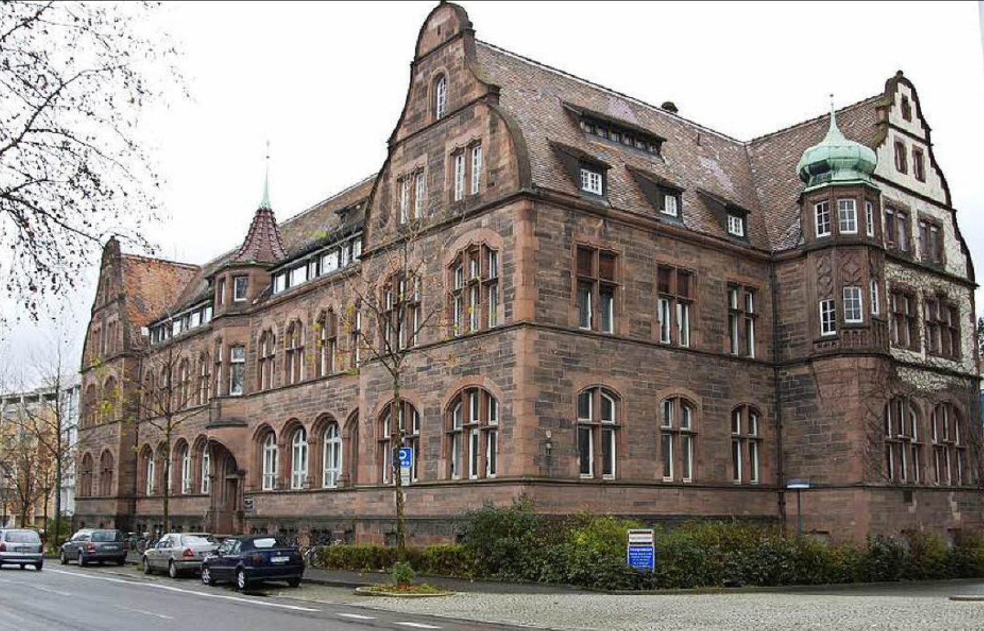





Our institute
Institute of Medical Biometry and Statistics (IMBI)
Health Service Research
Prof. Erik Farin-Glattacker
Clinical Epidemiology
Prof. Martin Wolkewitz
Stefan Meier Str. 26, 79104 Freiburg
Machine Learning
Prof. Harald Binder
- Head of the Institute -
Statistical Consulting
Prof. Dieter Hauschke
Dr. Erika Graf
Medical Informatics
Dr. Martin Boeker
Systems Biomedicine
Dr. Clemens Kreutz

Slide 4
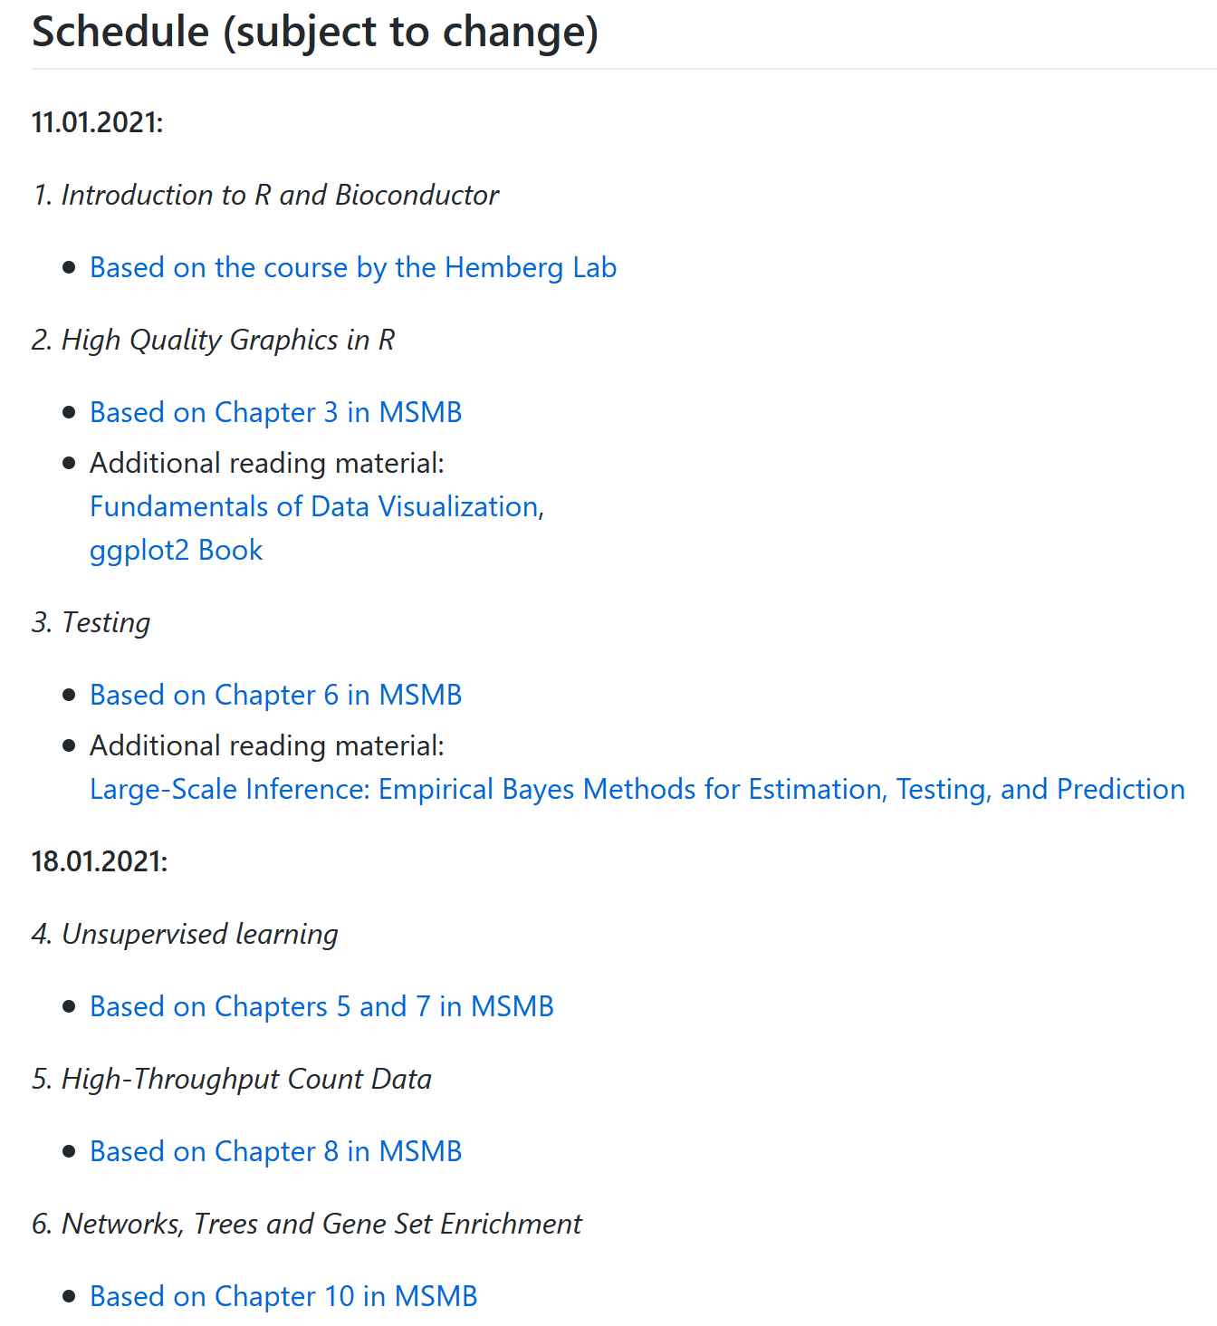
Schedule
https://github.com/MTreppner/AdvancedRforBiologists
9:00 – 12:00
13:00 – 14:30
15:00 – 16:30
9:00 – 10:30
11:00 – 12:00
13:00 – 13:30
14:00 – 15:30

Slide 5

What‘s the goal of this course?
Learning Soccer
Speed & precision,
Advanced team tactics
Expertise
Group play, basic tactics,
advanced technical skills
Understanding
Attacking, defending
Hands-on (experiences)
Passing & receiving, shooting
Basic skills
Coordinative skills, ball mastery

Slide 6
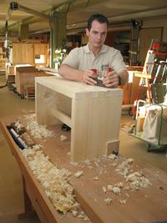
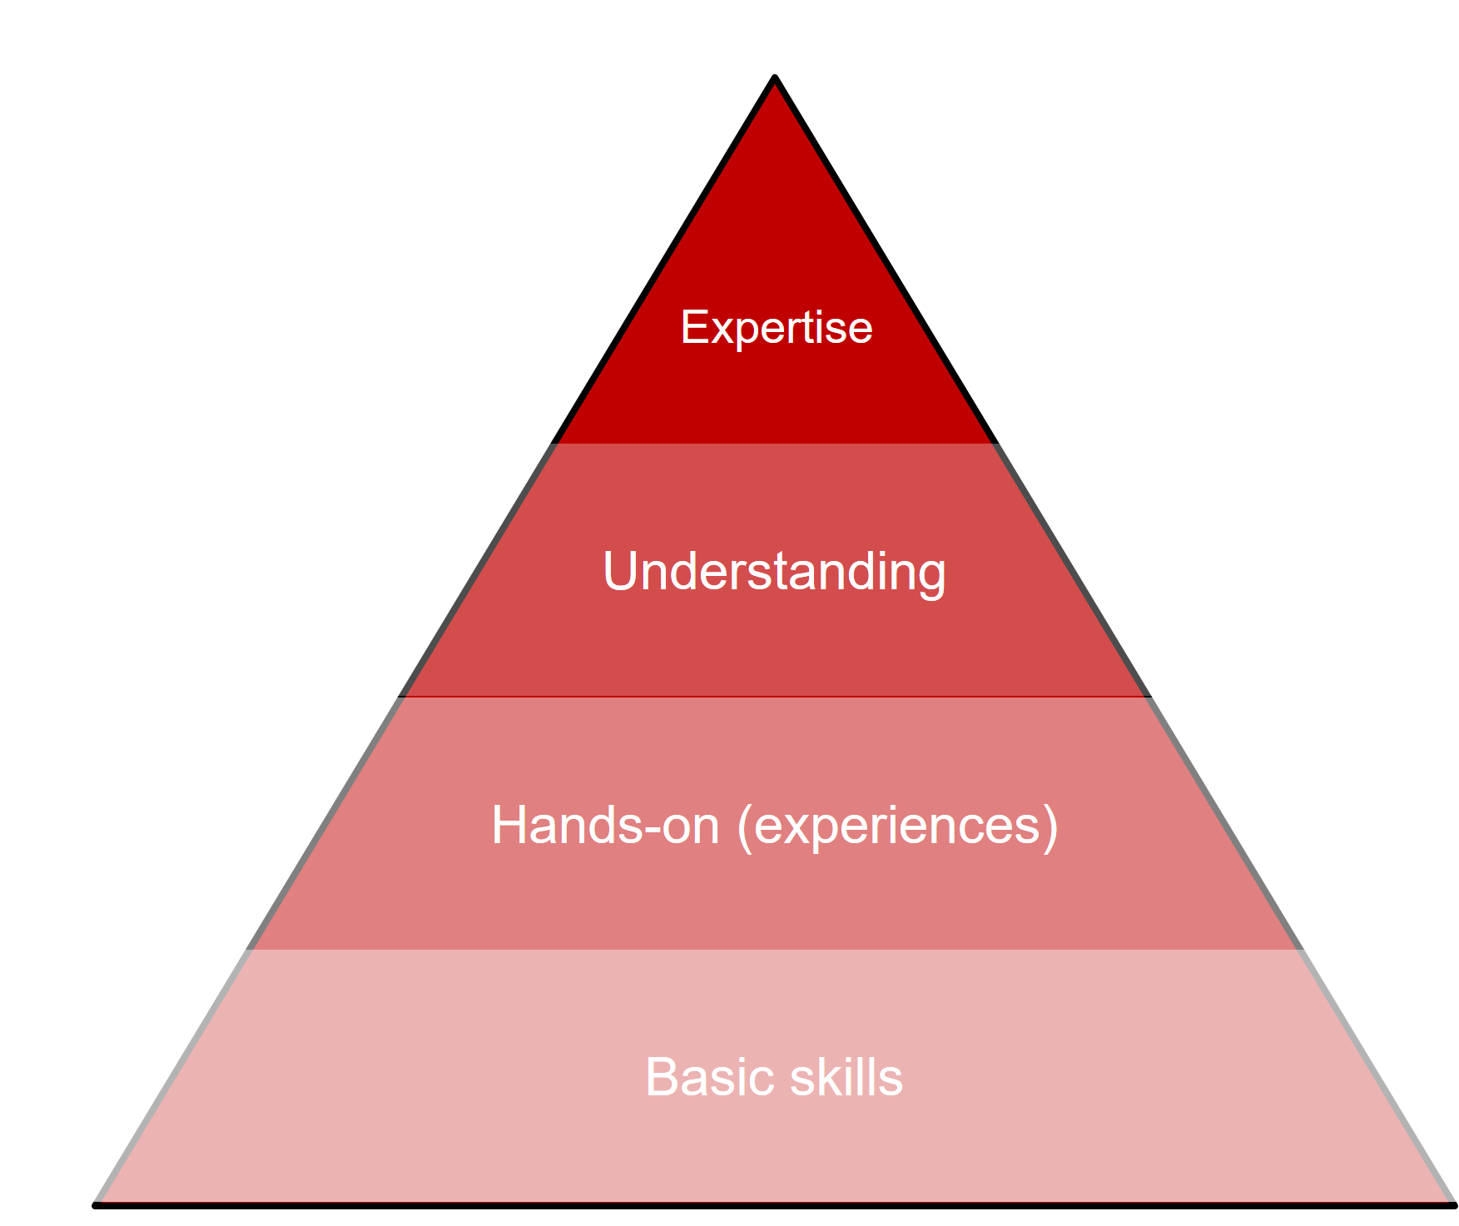
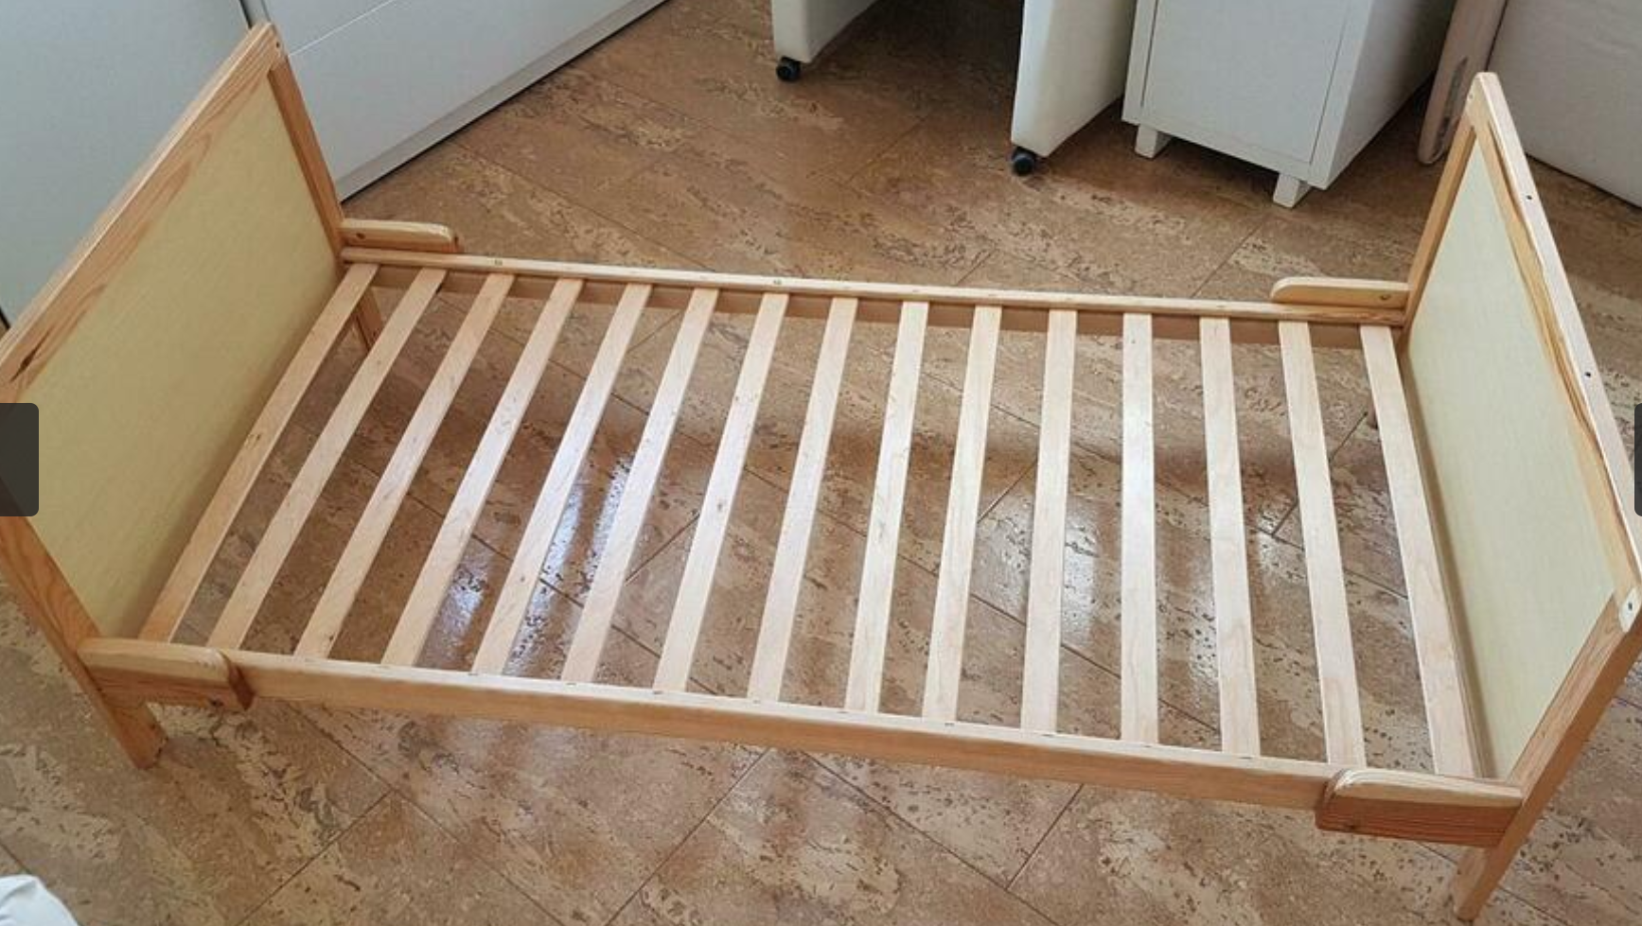
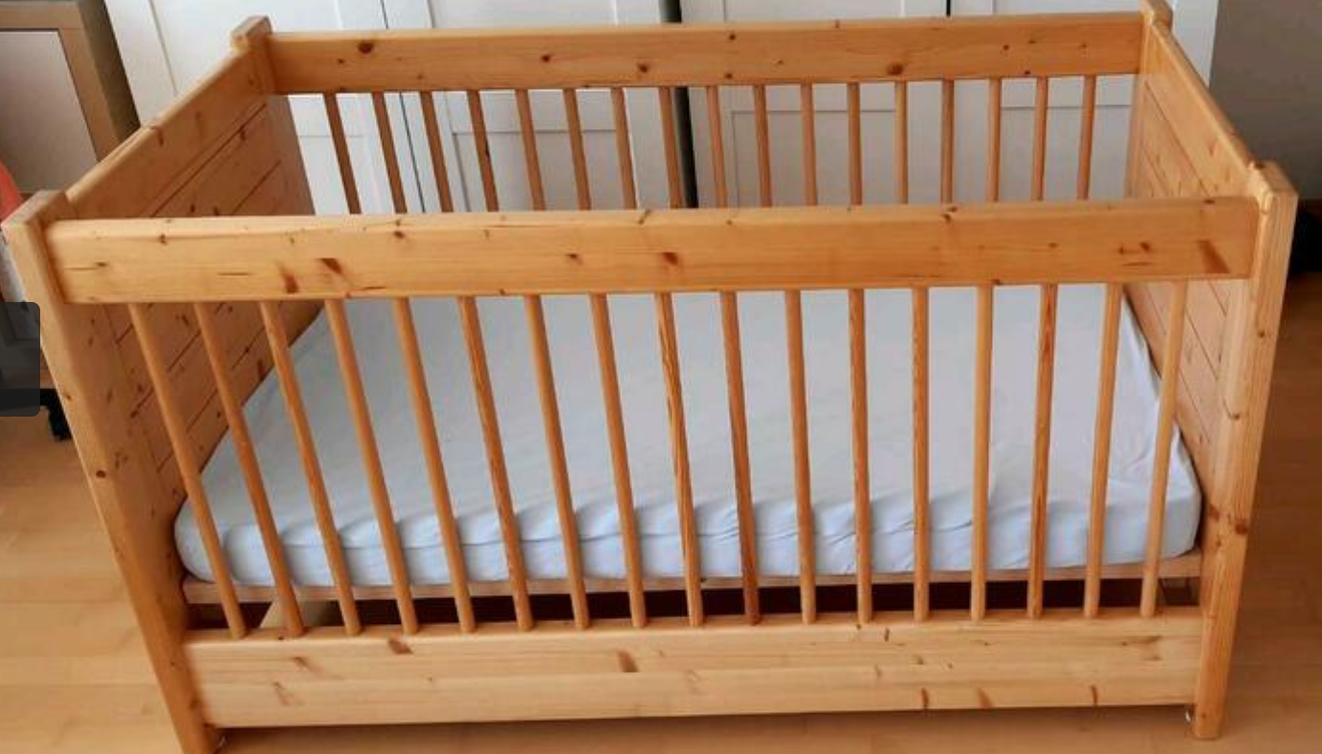
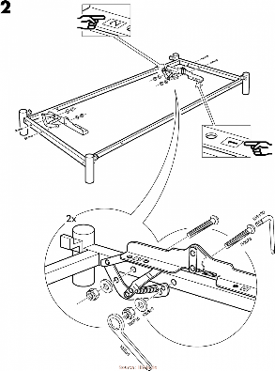

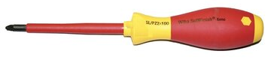
Learning
furniture construction
low quality
high quality

Slide 7
Learning R
What this course should provide…
Own approaches
Recognizing issues/errors
Recognizing suboptimality & issues Successful improvements
Selecting approprate
approaches & parameters
Tests & validations
Usage of available approaches and packages
Programming environment
R syntax

Slide 8
Our main goal
The larger the basis, the higher the pyramid
Secondary goal
Primary goal
Basic skills in R
We intend to expand skills
Give ideas (important and forthcoming topics)
Most valuable statistical approaches for bioinformatic analyses
Gain experiences & further improve your expertise
Our
course

Slide 9
1. Introduction to R and Bioconductor
Topics of this lesson
The R programming environment
The most important commands
Recap: arrays, matrices, indices
Recap: Important functions
Pipe operator
Markdown files
Repositories for R packages
Concepts of R programming:
Classes, methods, …
The most important Bioconductor classes
Making your own package
Debugging
Several topics might be (partly) known → are sometimes partly rather briefly discussed
Notes:
facilities of Rstudio

Slide 10
R Programming Environment

Slide 11
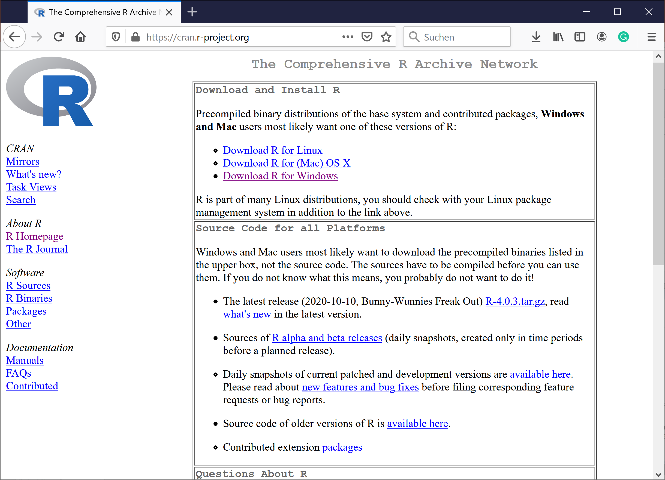
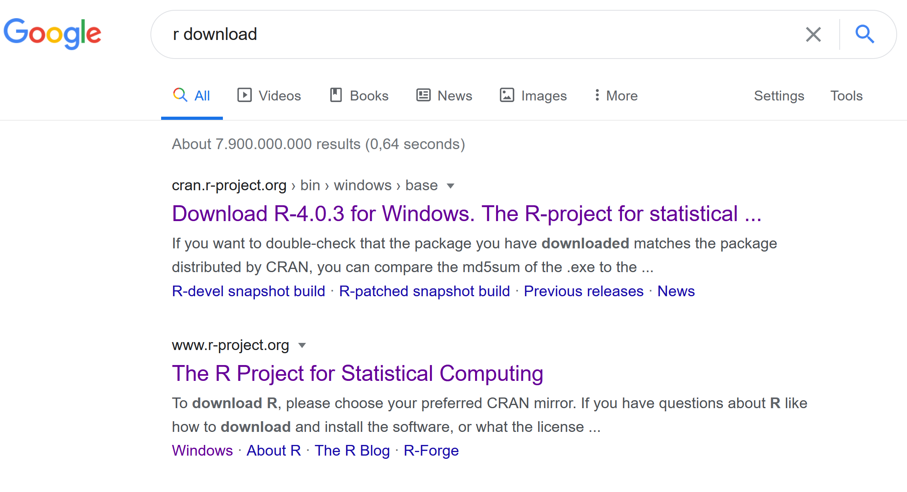
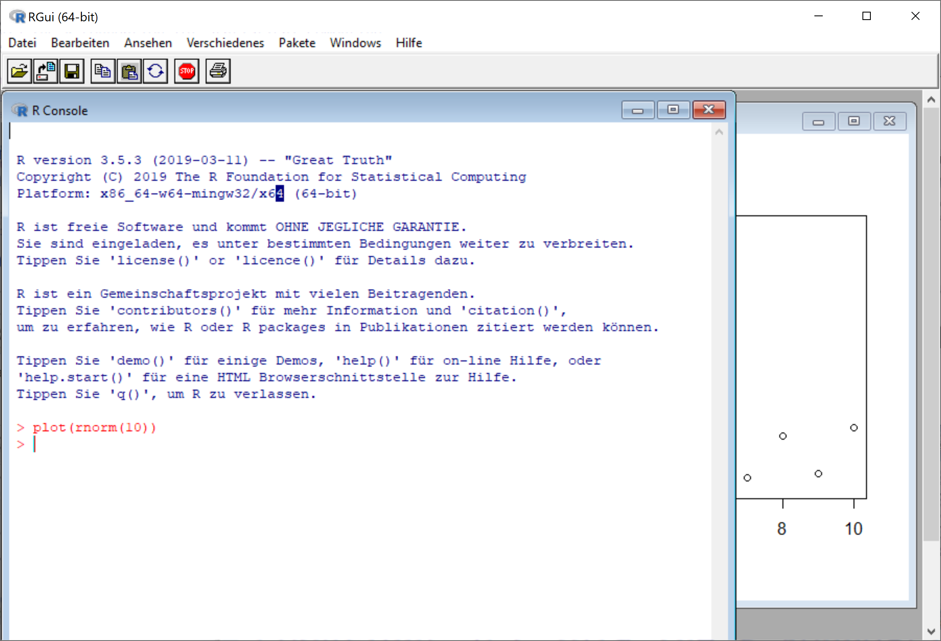
Installation of R

Slide 12
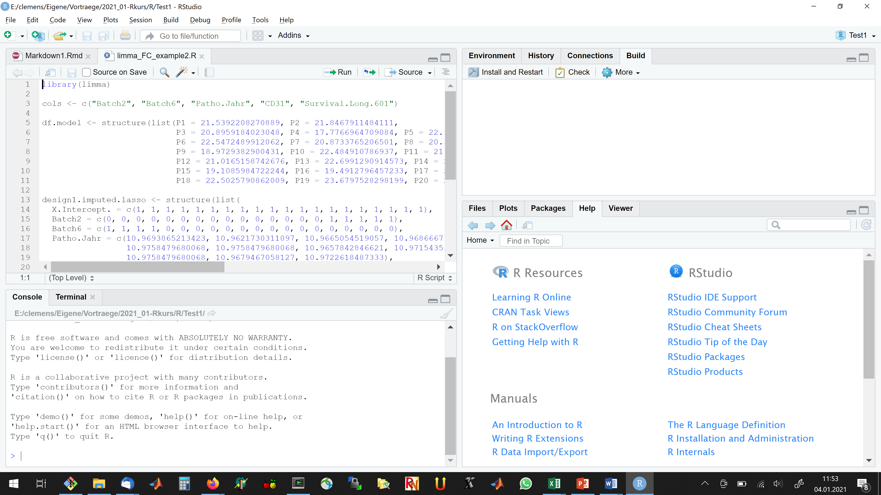
R-Studio
The most powerful R programming environment (IDE)
“An integrated development environment (IDE) is a software application that provides comprehensive facilities to computer programmers for software development.” (Wikipedia)

Slide 13
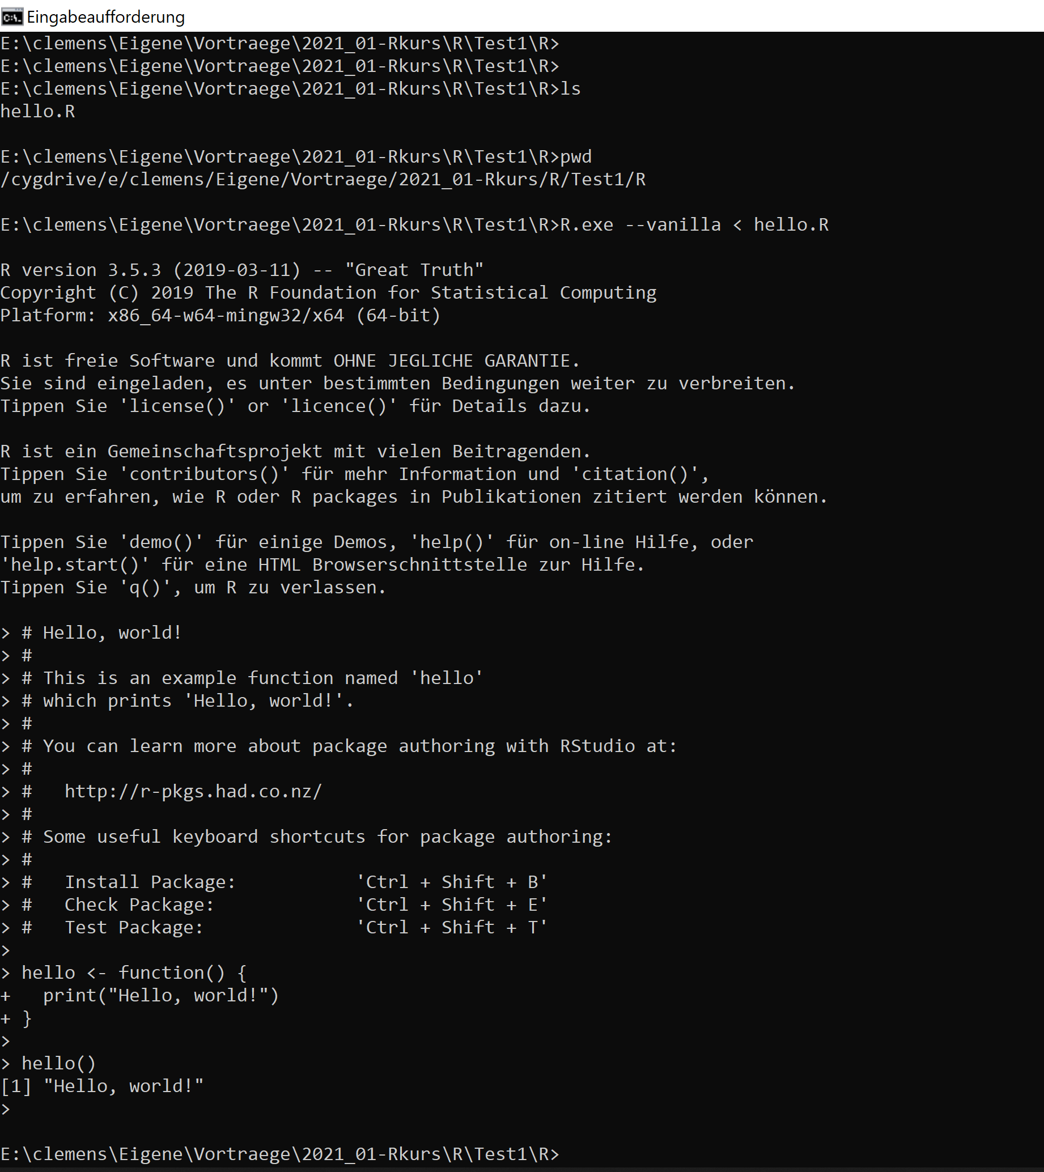
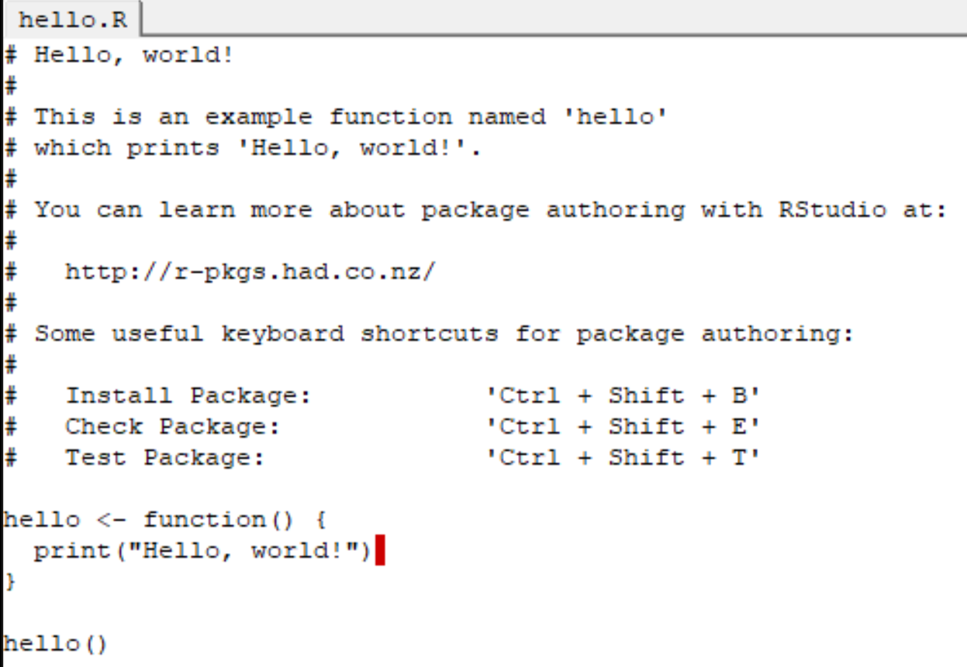
R from command line
Enables
calculation on compute servers (e.g. via ssh)
calculation in the background (via nohup or screen)
automatic execution of pipelines (e.g. via cron/crontab)
integration to other scripts or programming languages

Slide 14
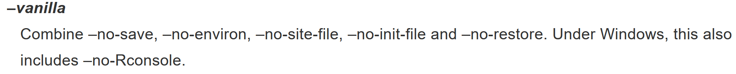
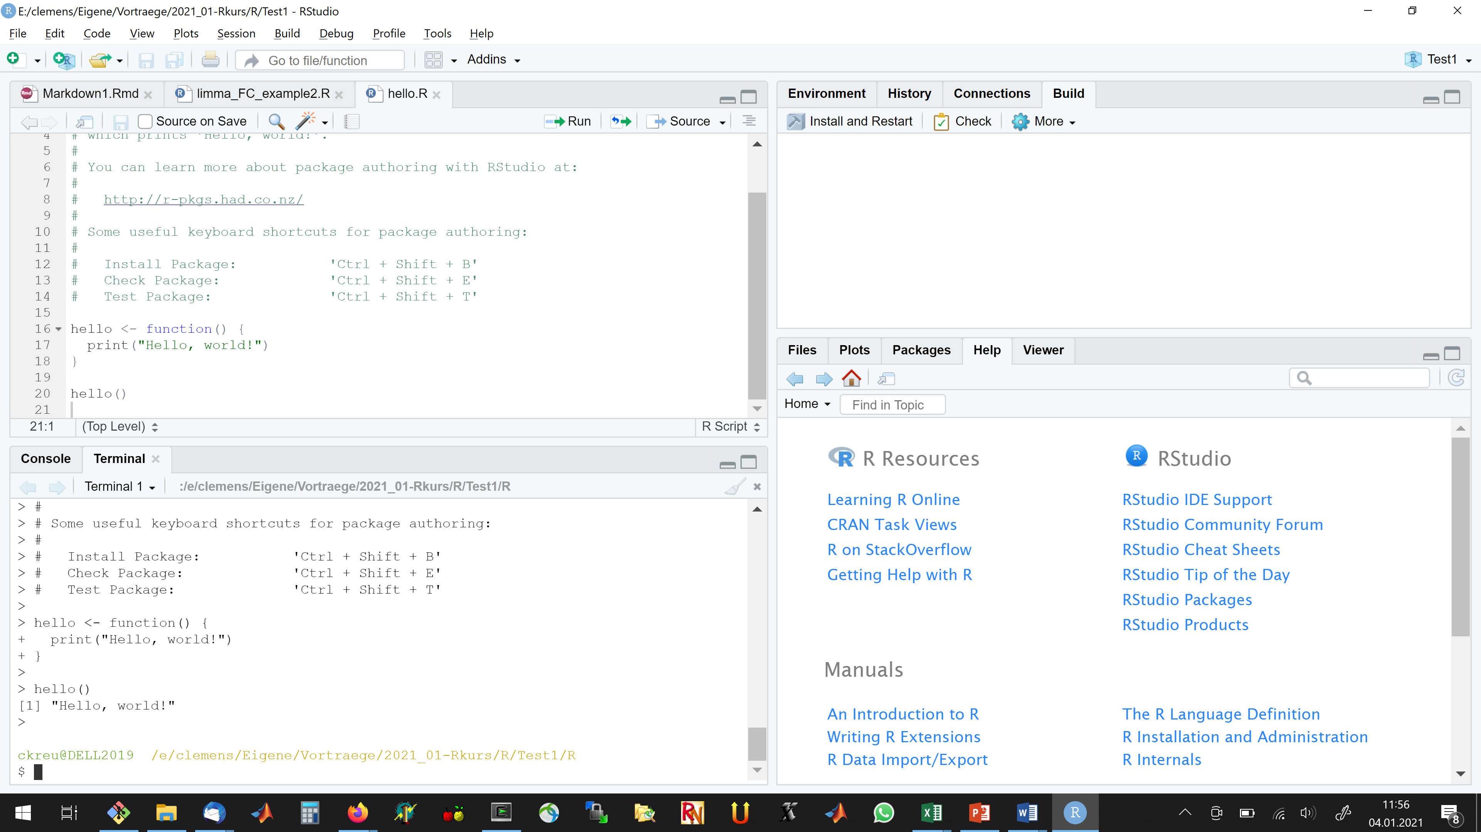
R from command line
R –vanilla < myProgram.R

Slide 15
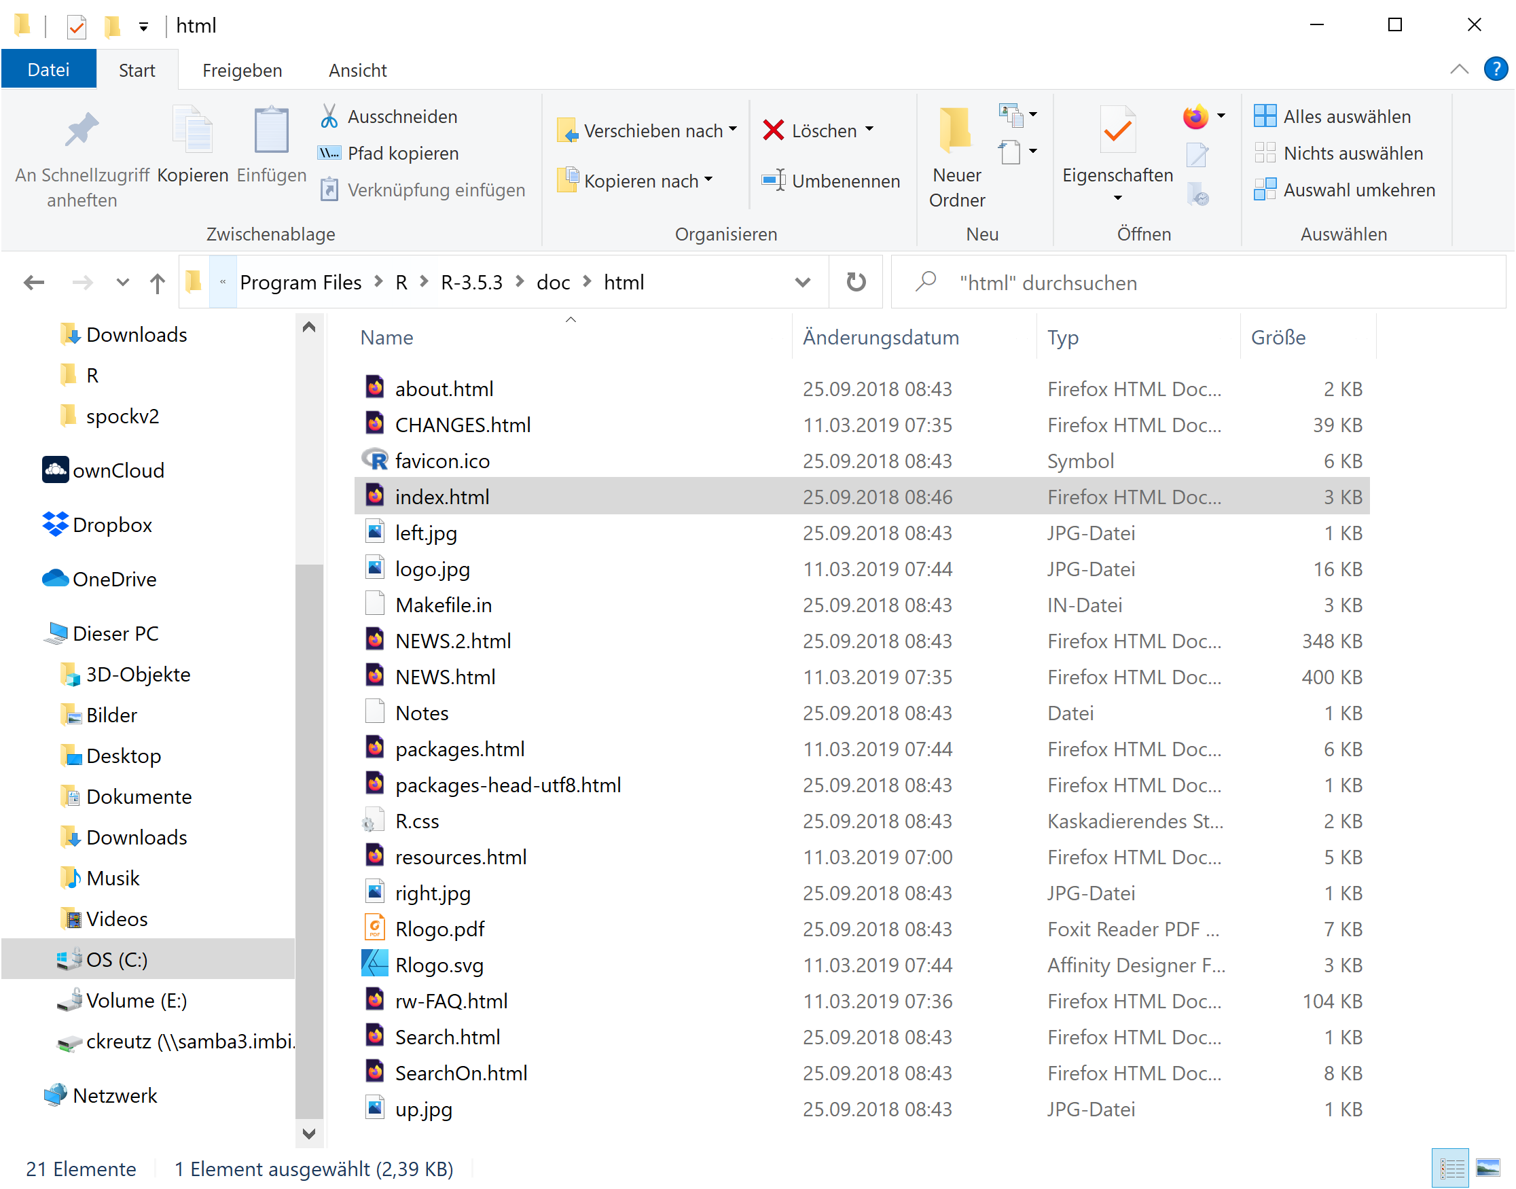
Getting help
Help commands
?lapply, help(lapply)
Documentation pages provided in Rstudio
help.start(): Html pages
also available in the R installation folder, see .libPaths()
args(lapply)
vignette(„tibble“) for facilities of packages (if available)
browseVignettes() for displaying all available vignettes
demo() for code demonstrations (if available)
apropos() e.g. apropos(„^glm“)
?? or help.search()

Slide 16
Syntax of vectors, matrices, …

Slide 17
Indexing
see 1_Indexing.Rmd
Vectors
Matrices
Lists

Slide 18
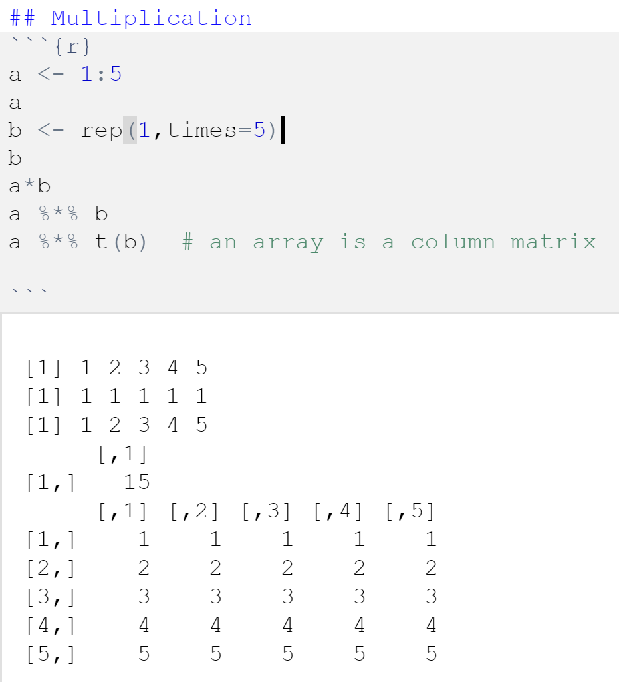
Vector operations
Elementwise vs. matrix multiplication

Slide 19
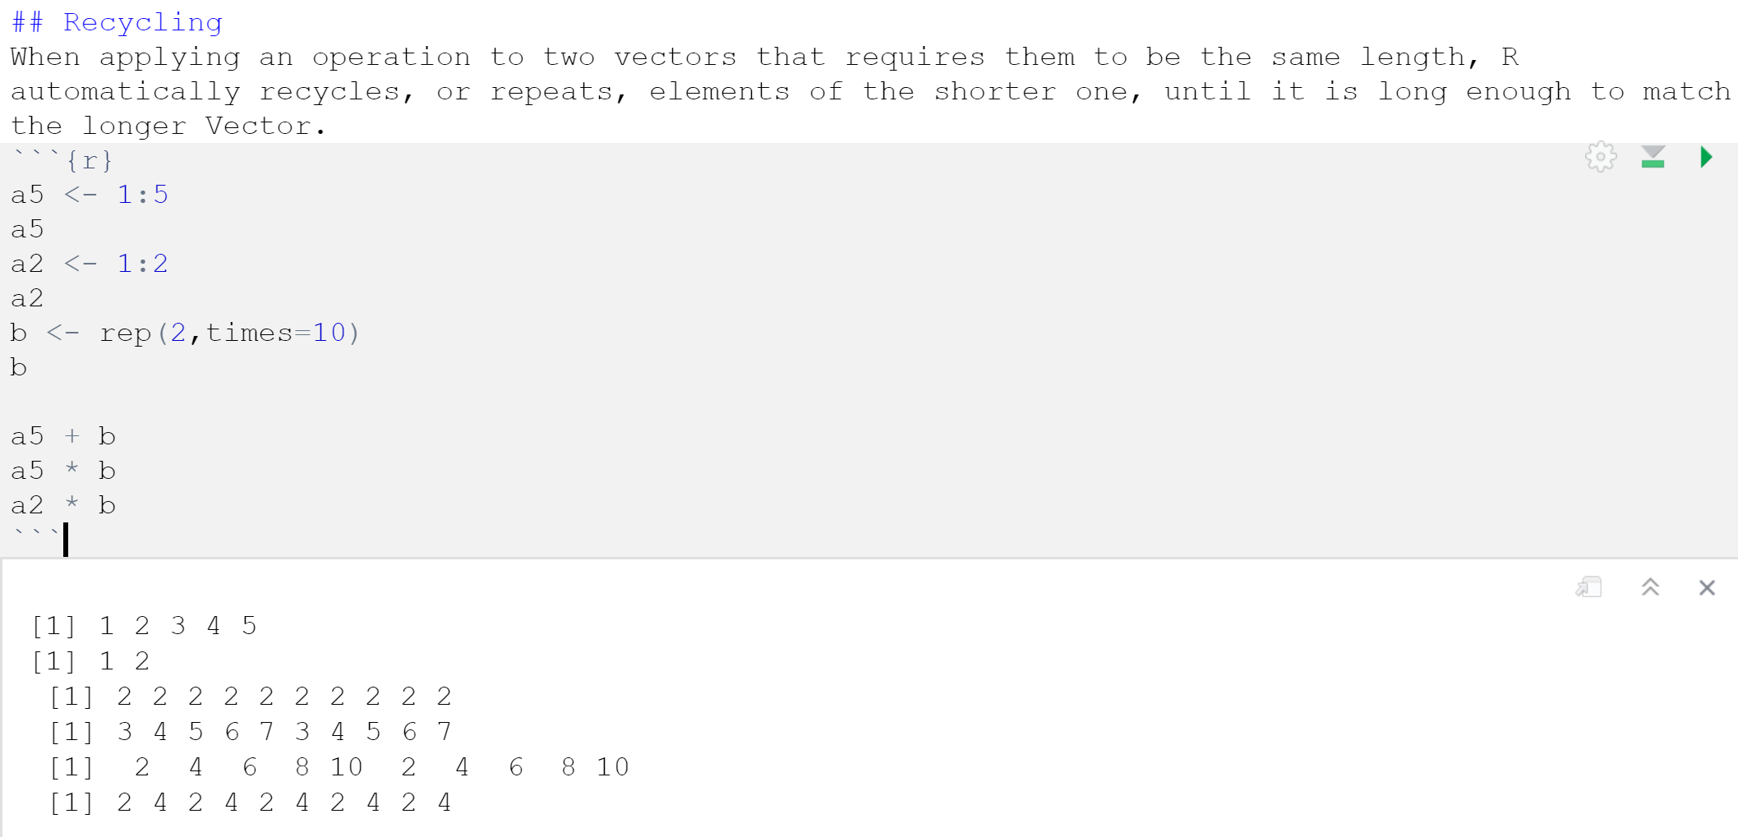
Recycling
Caution: For vector arithmetic operations elements might be recycled!

Slide 20
(Important) functions

Slide 21
Important R commands
str
class
dimnames
names
attr
attributes
Base package
c()
cbind()
rbind()
cat()
t()
which
unique
as.matrix
as.numeric
as.character
as.factor
save
save.image
load
write.table
write.csv
read.table
seq
rep
rev
sample
paste(…, sep=““, collapse=““)
paste0
array()
matrix()
list()
data.frame()
ls()
rm(list=ls())
replace
sub
grep
runif
rnorm
dnorm
cnorm
apply
lapply
sapply
tapply
t.test
wilcox.test
fisher.test
lm
anova
lme
plot
print
summary
mean, median, sd, …
max, min,
sum, colSums, rowSums,

Slide 22
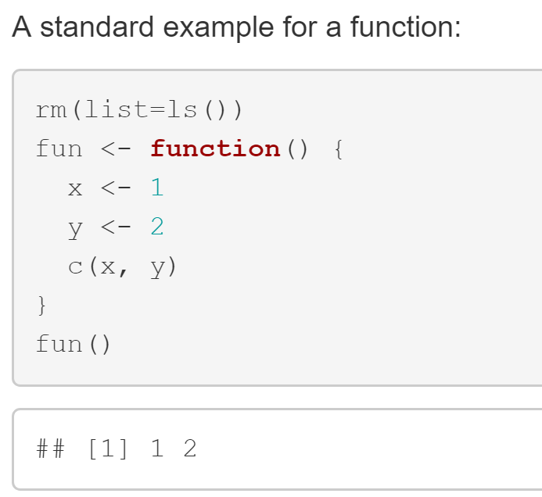
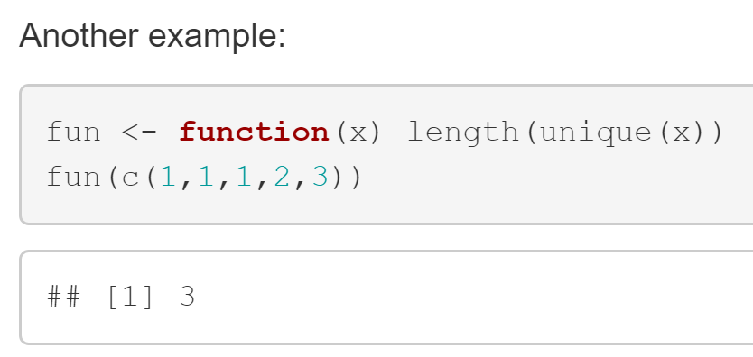
Functions
How to define your own function

Slide 23
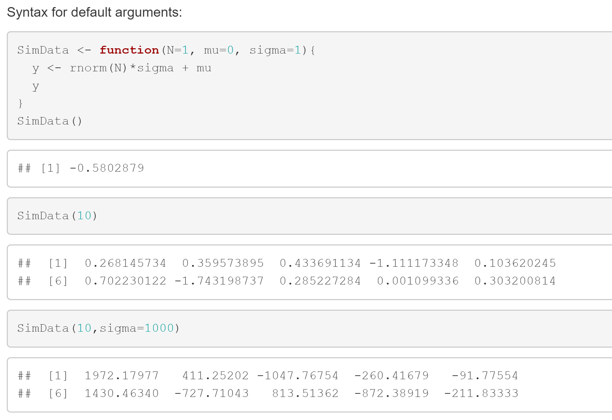
Functions
Default arguments & named arguments

Slide 24
Some characteristics of functions in R
Functions can be
assigned like other values
stored in lists
passed as arguments to other functions
created inside of other functions
returned as output by other functions

Slide 25
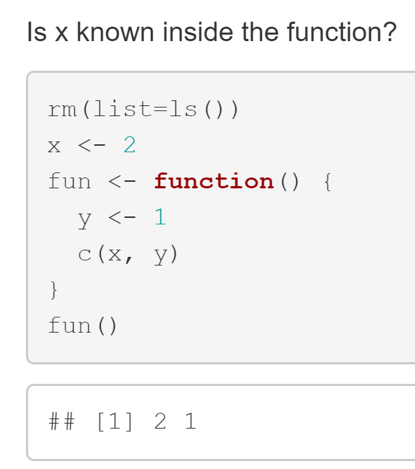
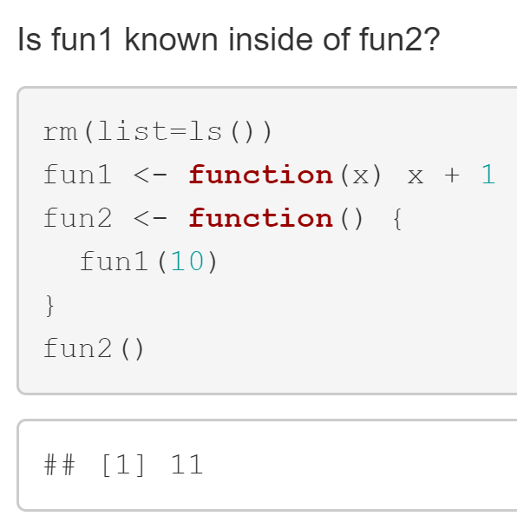
What do you expect?
Let‘s vote!
R looks all the way up to the global environment („Scoping“)

Slide 26
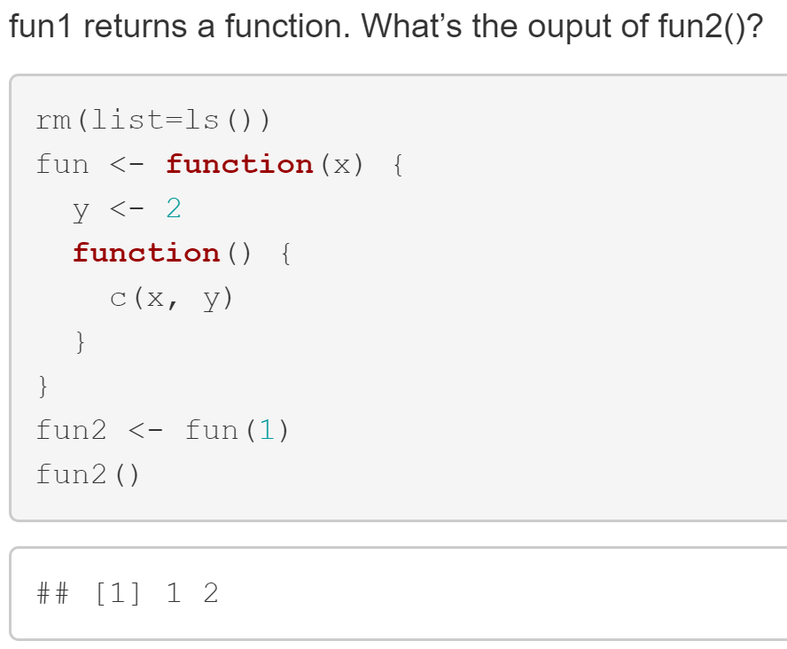
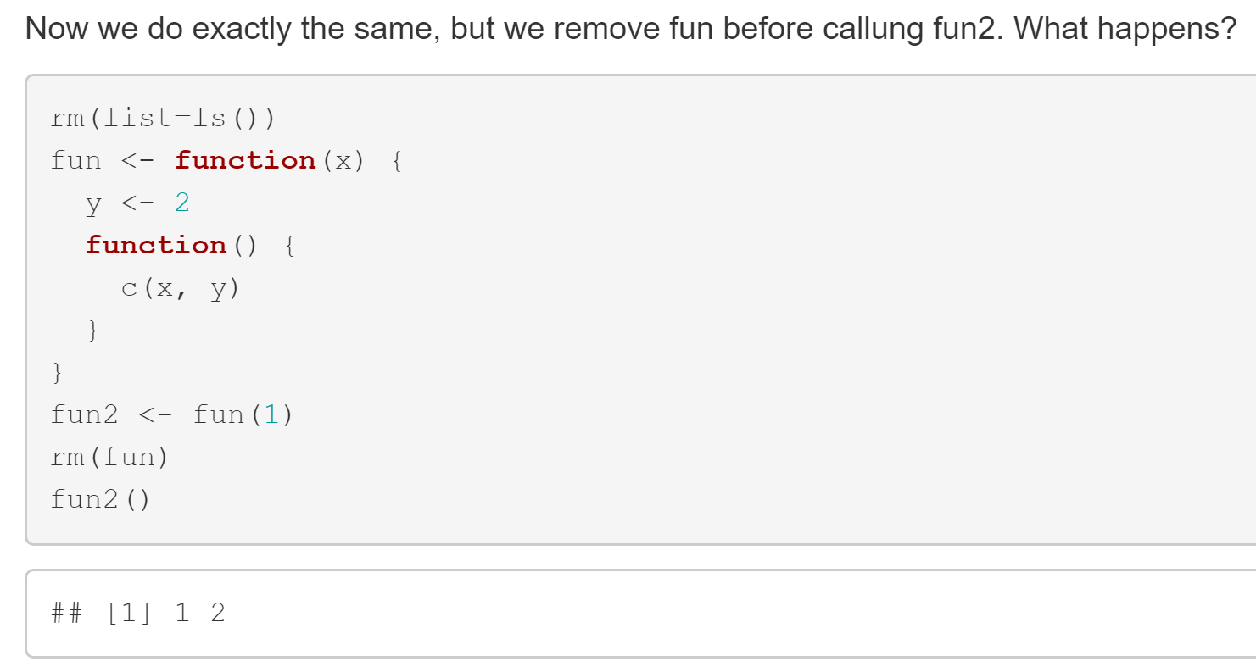
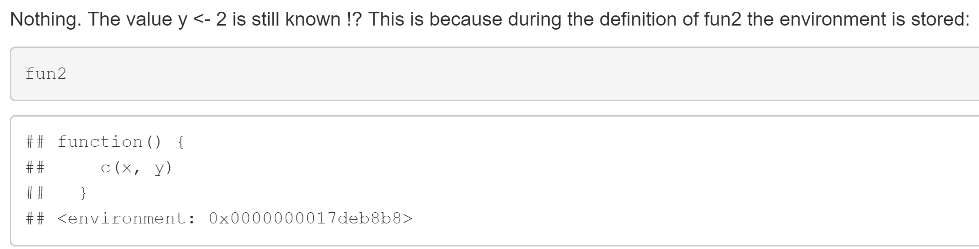
What do you expect?
Write it down to a piece of paper!

Slide 27
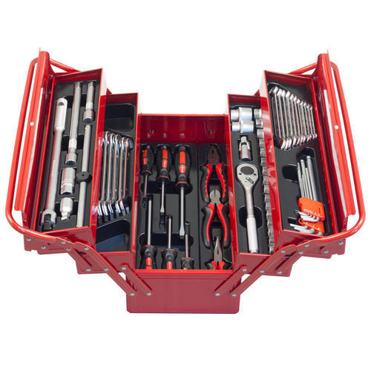
Functions
Why should you write your own functions?
Repeatedly done tasks should be written only once
Enables changes and code maintainance
Additional arguments
Default parameters
Checks of validity of the arguments
Handling of Inf, NA, …
Important to keep track of your code and your analyses
Build up your own toolbox!

Slide 28
Hands-on: function & command line
1) Write a simulation function and 2) execute it via command line
(Depends on whether we have time)

Slide 29
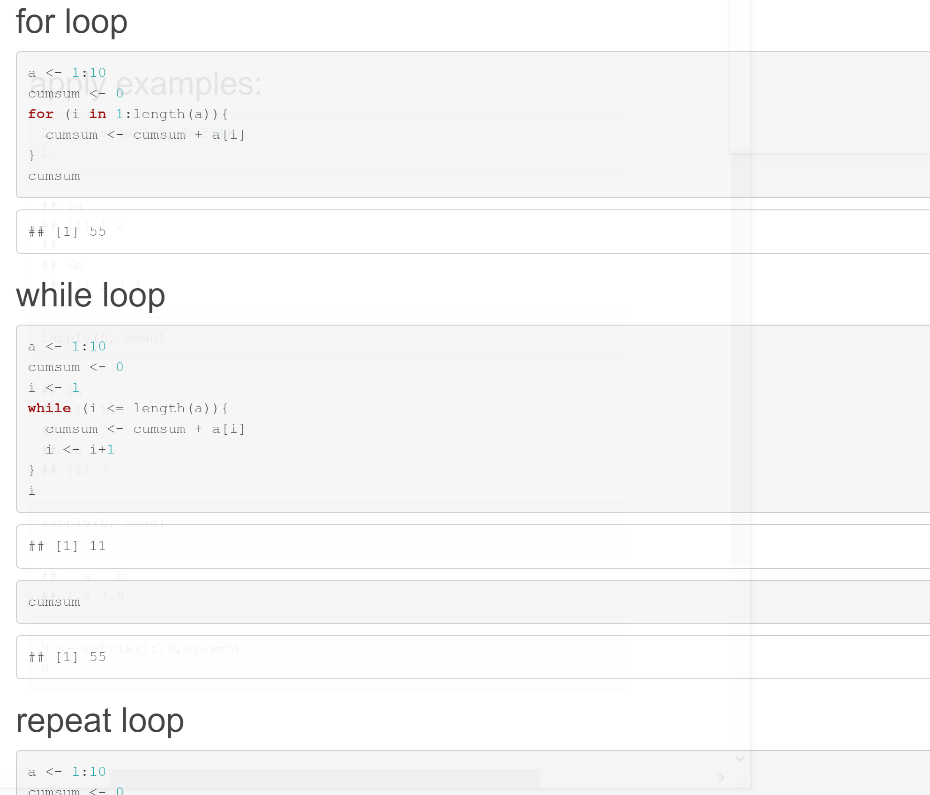
Loops
see 3_Loops.Rmd
for loop
while loop
repeat loop
When do we naturally need a while loop?

Slide 30
Hands-on: while loop
Draw standard normally distributed numbers and count until a value>2 is drawn

Slide 31
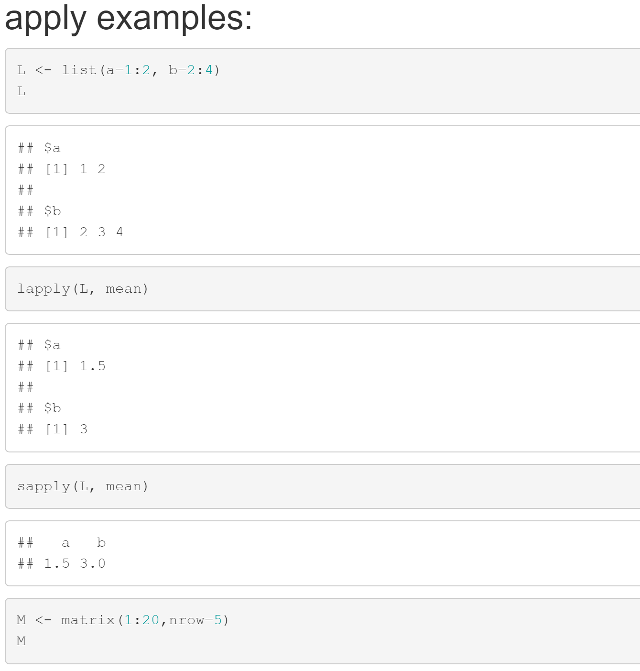
Preventing loops: apply functions
See apply.Rmd

Slide 32
Hands-on: lappy
Create a list of vectors with random entries, use lapply for calcution of medians of the list entries
The following functions might be helpful:
rnorm()
list()
lapply()
Compare the runtime with a for loop
Sys.time()

Slide 33
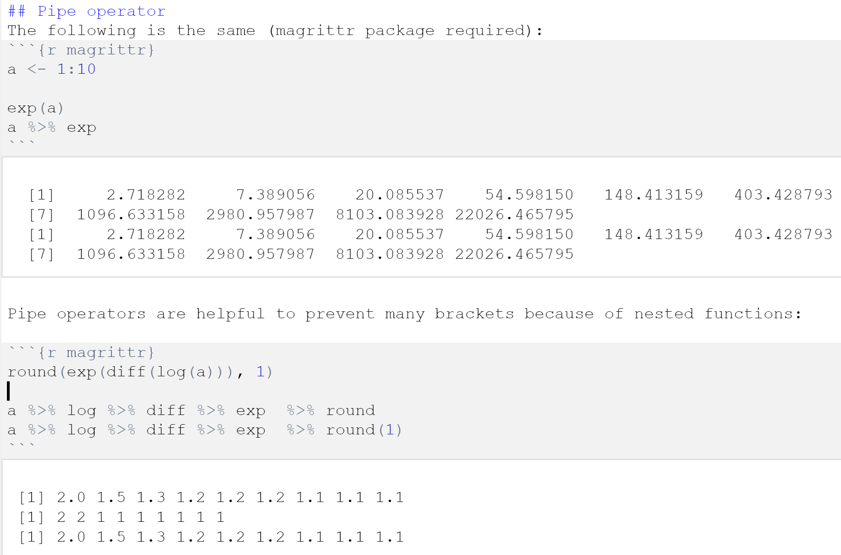
Pipe operator
magrittr package (or dplyr)

Slide 34
Markdown files

Slide 35
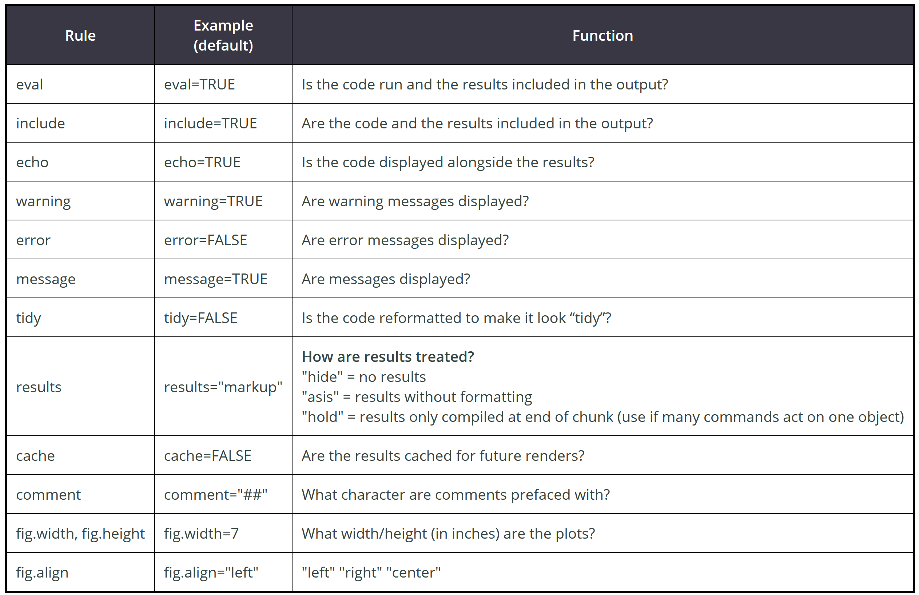
Markdown files
Source code & outcomes at one glance
powerpoint
html
pdf
Big advantage: Reproducibility

Slide 36
Hands on: Markdown files, data simulation
Try to implement the following within an Rmd file
Write a simulation function for creating a data matrix e.g. normally distributed numbers
Use the function for creating 2 data matrices
Write a function for applying the t-test for each line
Use the function for performing the tests
Plot histogram of the p-values

Slide 37
R packages repositories

Slide 38
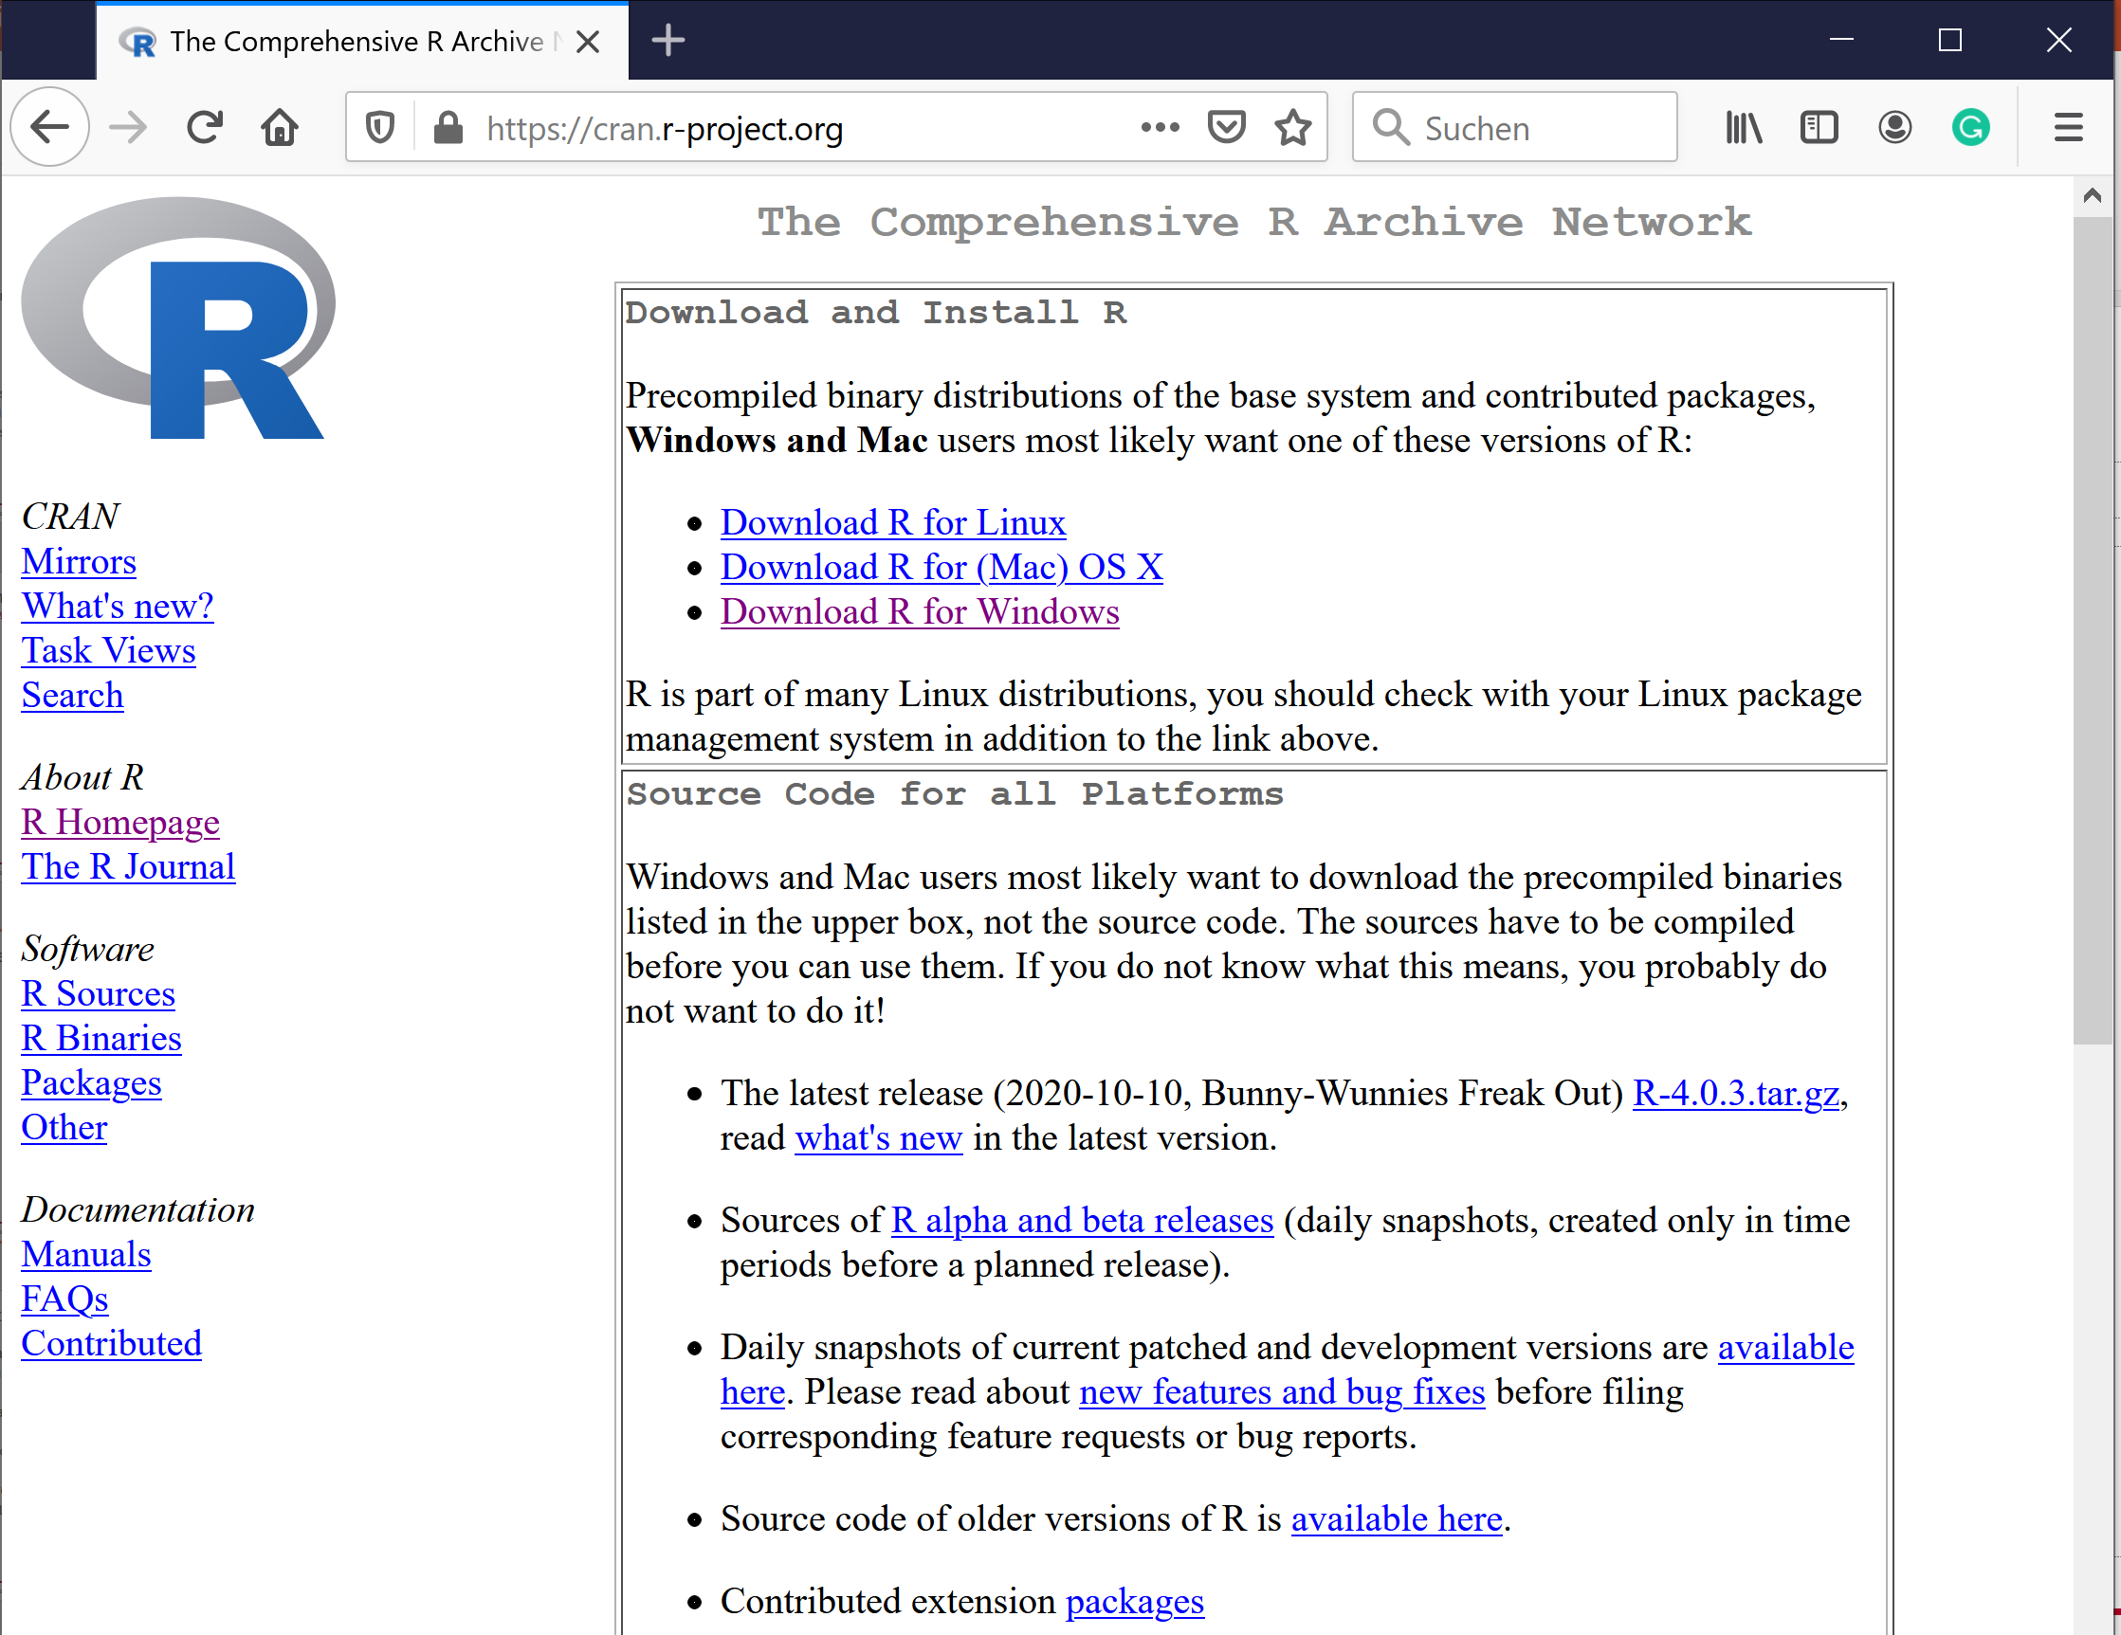
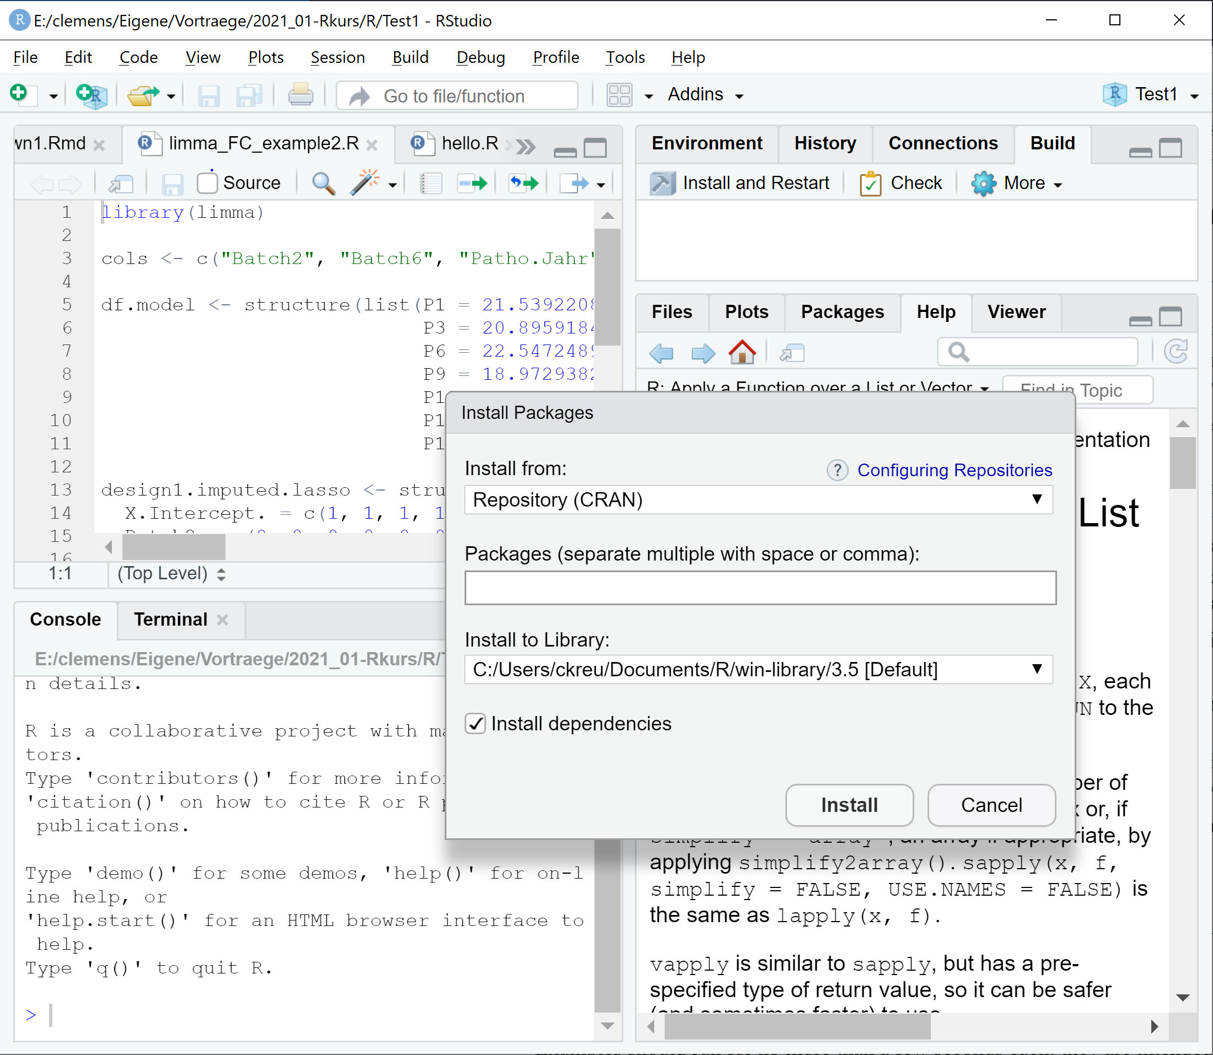
R repositories
CRAN – The Comprehensive R Archive Network
No application focus
Basic requirements for package submissions
Default package source

Slide 39
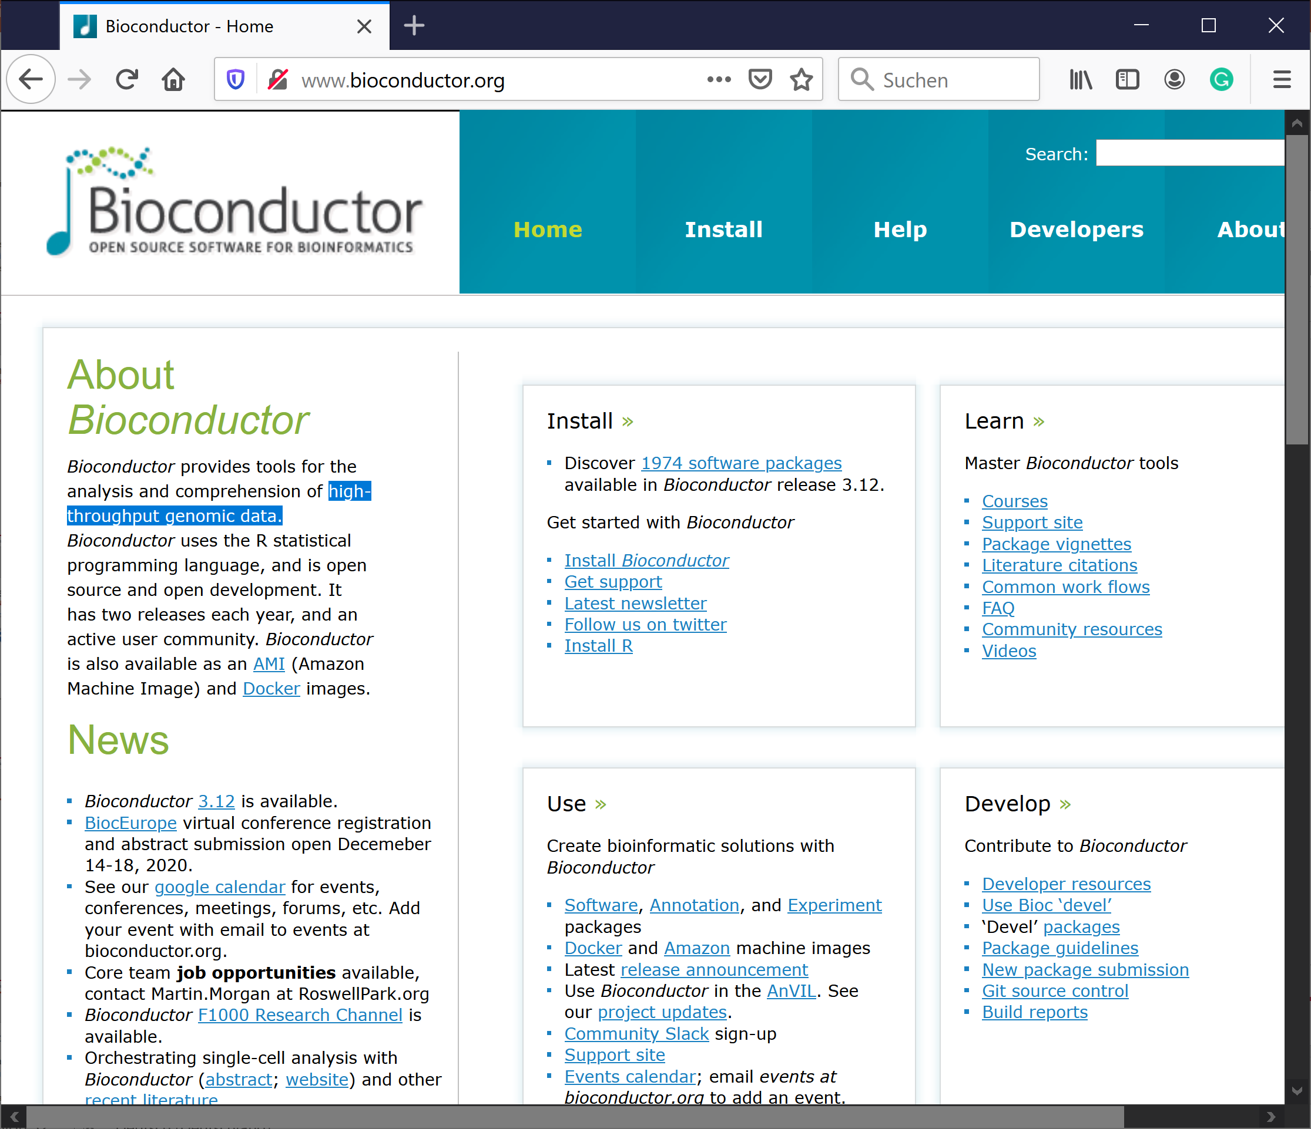
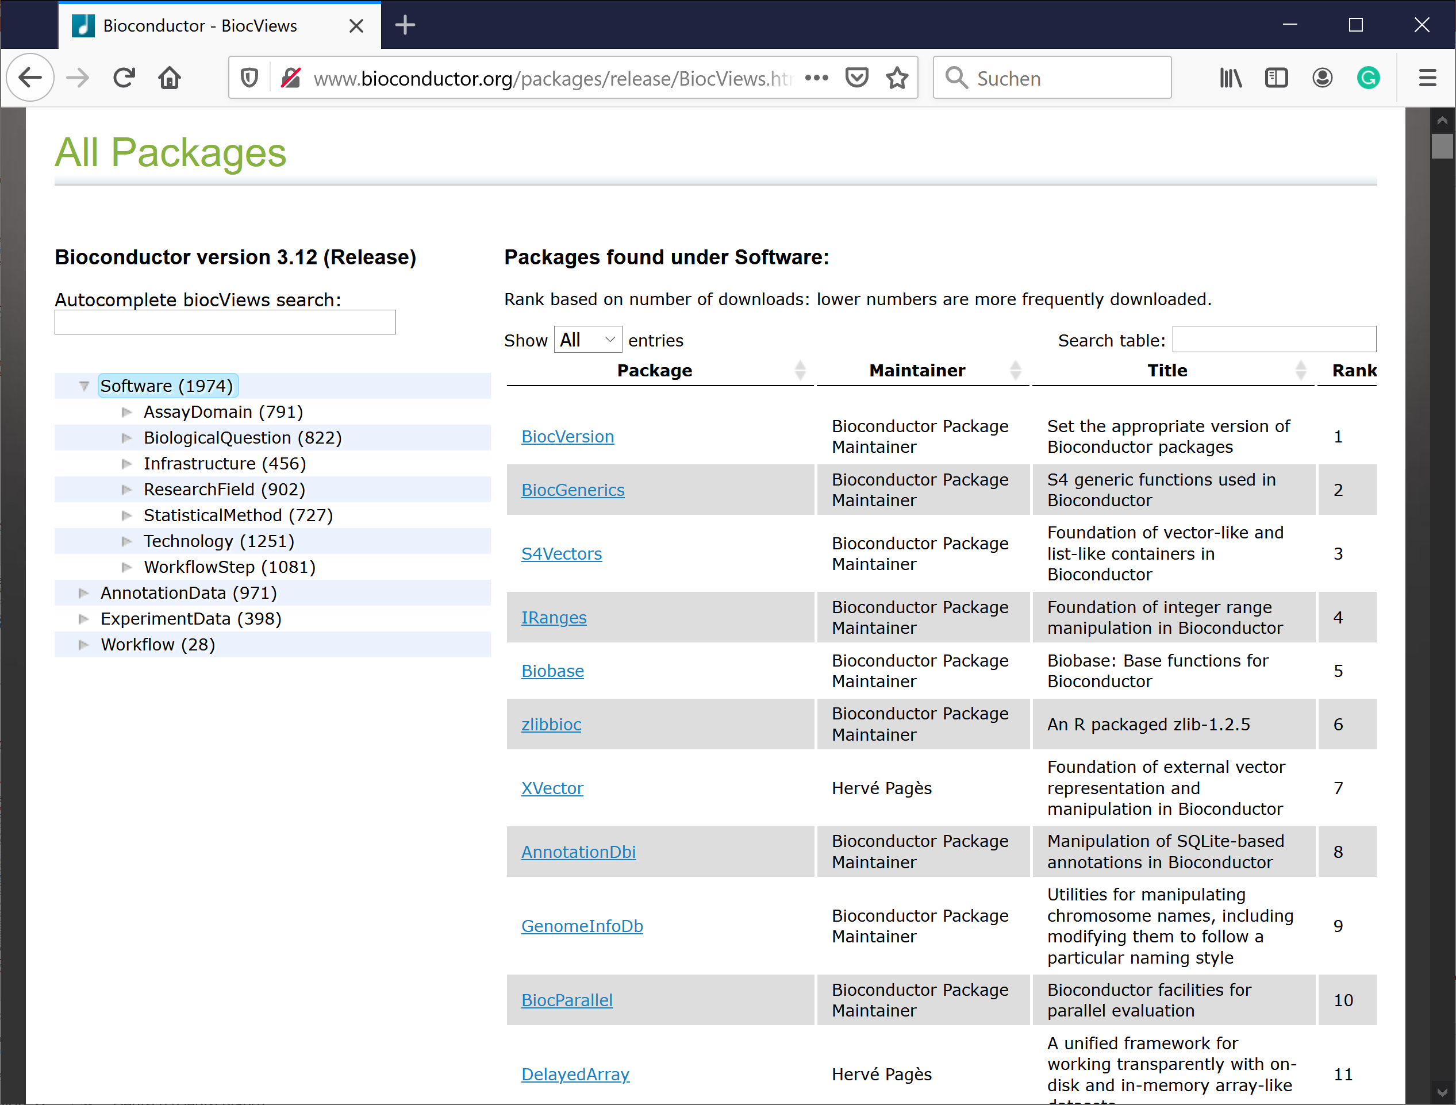
Bioconductor
R repository for high-throughput data

Slide 40
Installation of packages
CRAN, Bioconductor, github, local
install.packages("devtools")
require("devtools")
source("https://bioconductor.org/biocLite.R")
biocLite("edgeR")
Local zip or tar.gz file: http://www.bioconductor.org/packages/release/bioc/html/edgeR.html
devtools::install_github("tallulandrews/M3Drop")

Slide 41
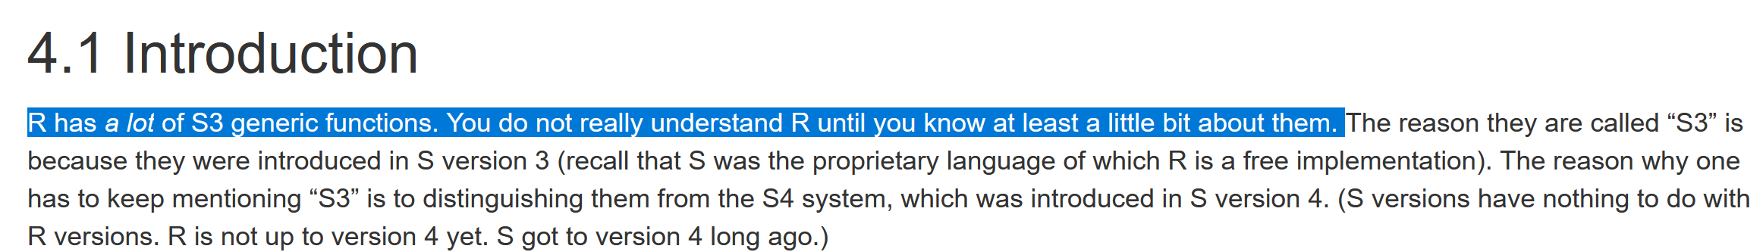
Object oriented programming in R

Slide 42
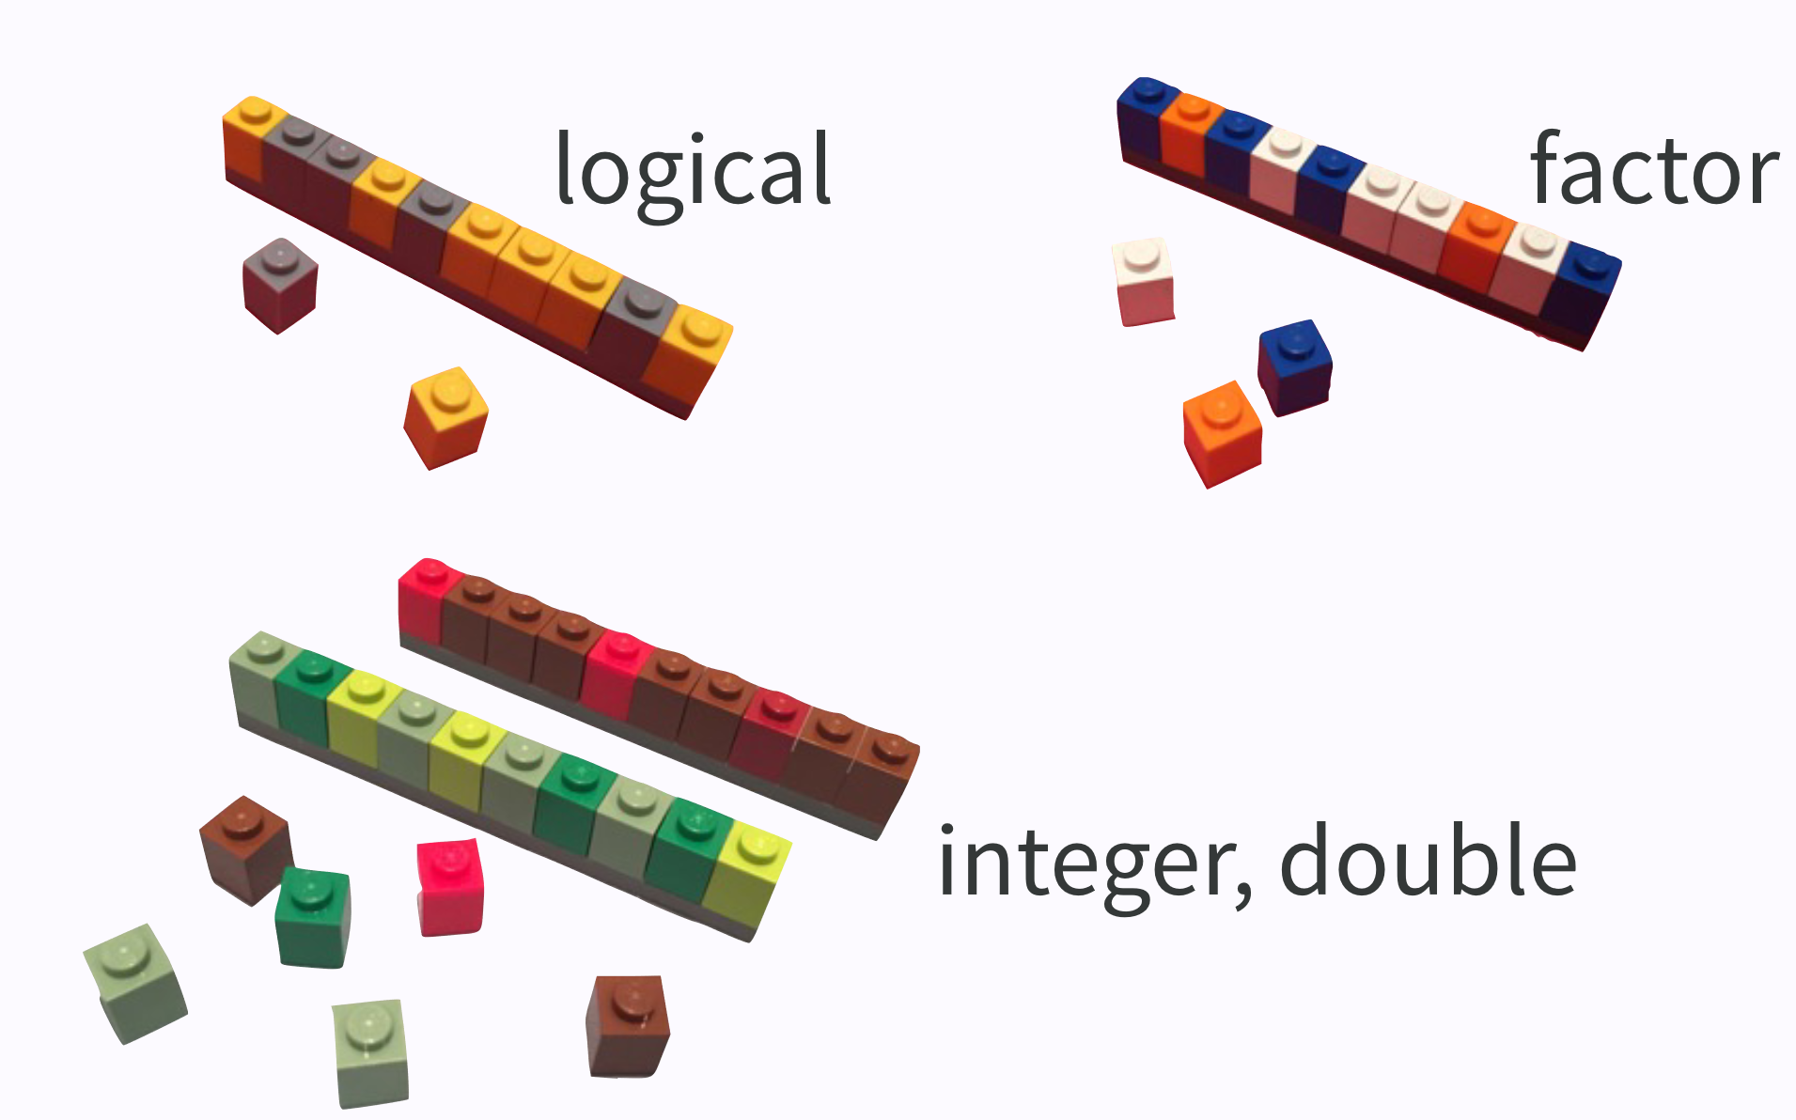
Integer, logical, factor
Can anybody explain the difference between these data types?
www.bioconductor.org

Slide 43
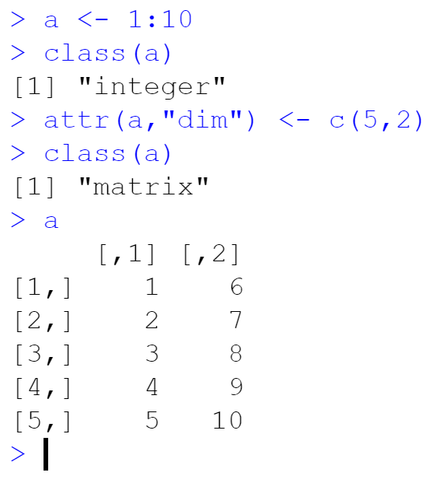
Common classes in R
a matrix is an array with
attr(, „dim“)
numeric, character
factor
logical
array, vector
matrix
list
data.frame

Slide 44
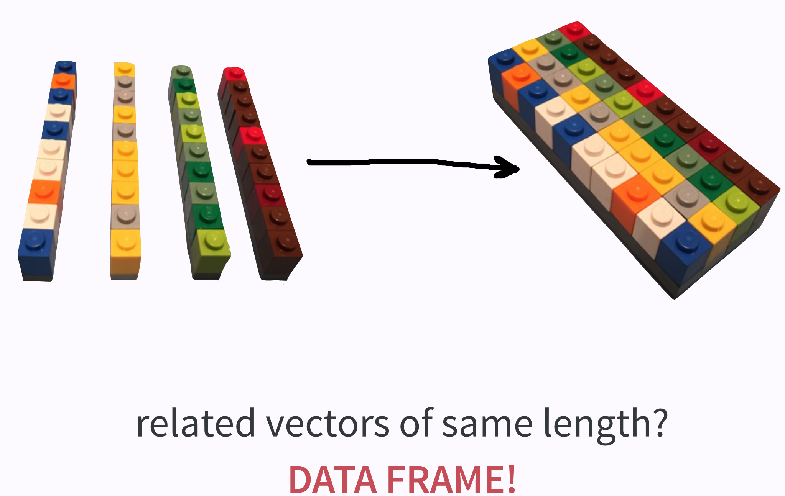
Data frames
Related elements of the same length => data.frame
www.bioconductor.org

Slide 45
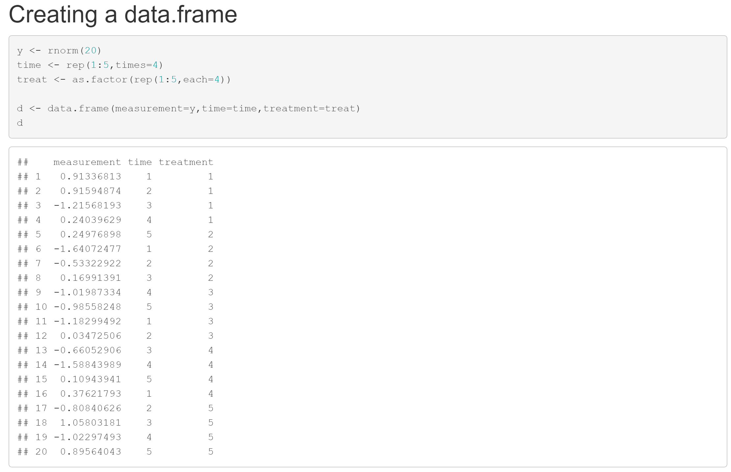
Data frames
See 6_Dataframes.Rmd

Slide 46
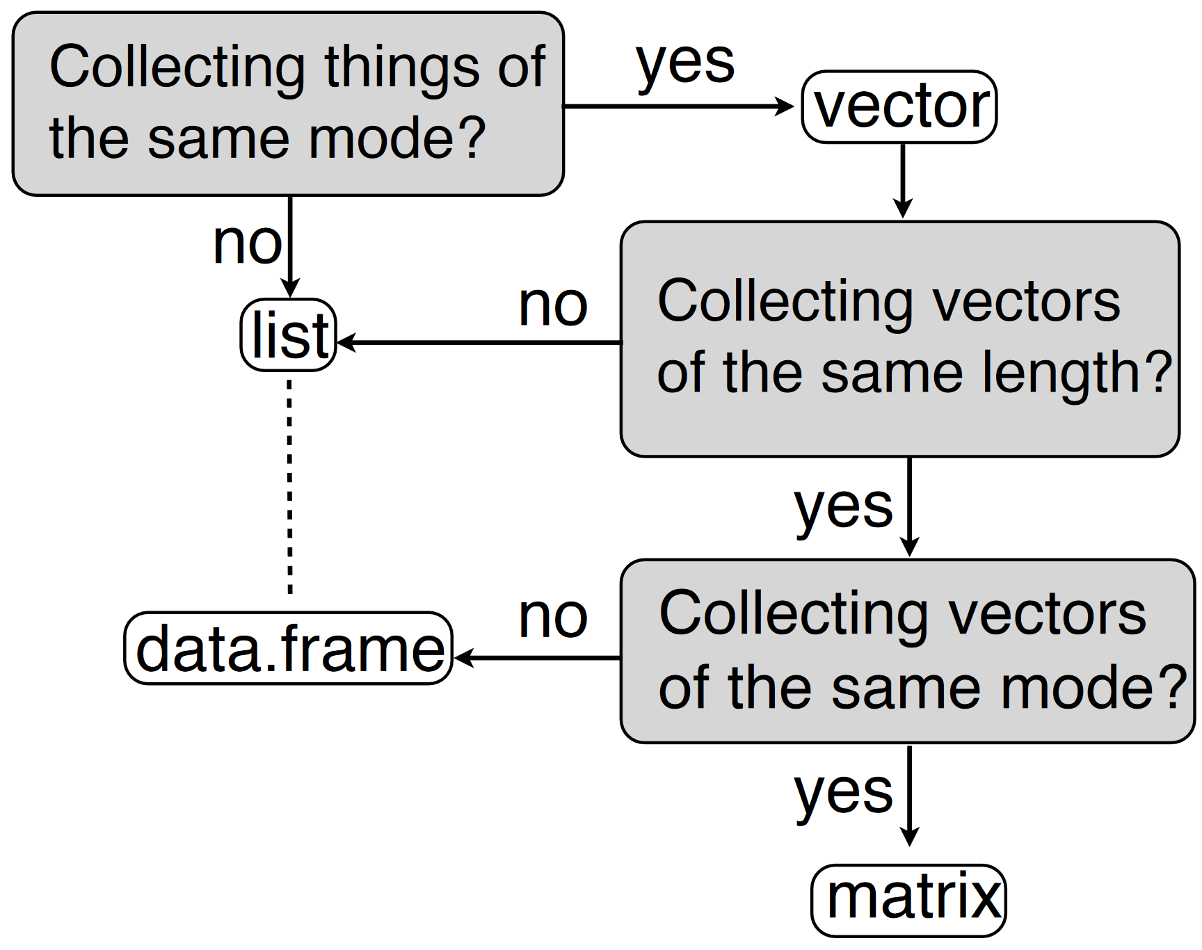
List, data.frame, matrix
Overview
matrix: „Rectangluar shape“ & „same class (mode)“
data.frame: „Rectangular shape“
list: Most flexible
www.bioconductor.org

Slide 47
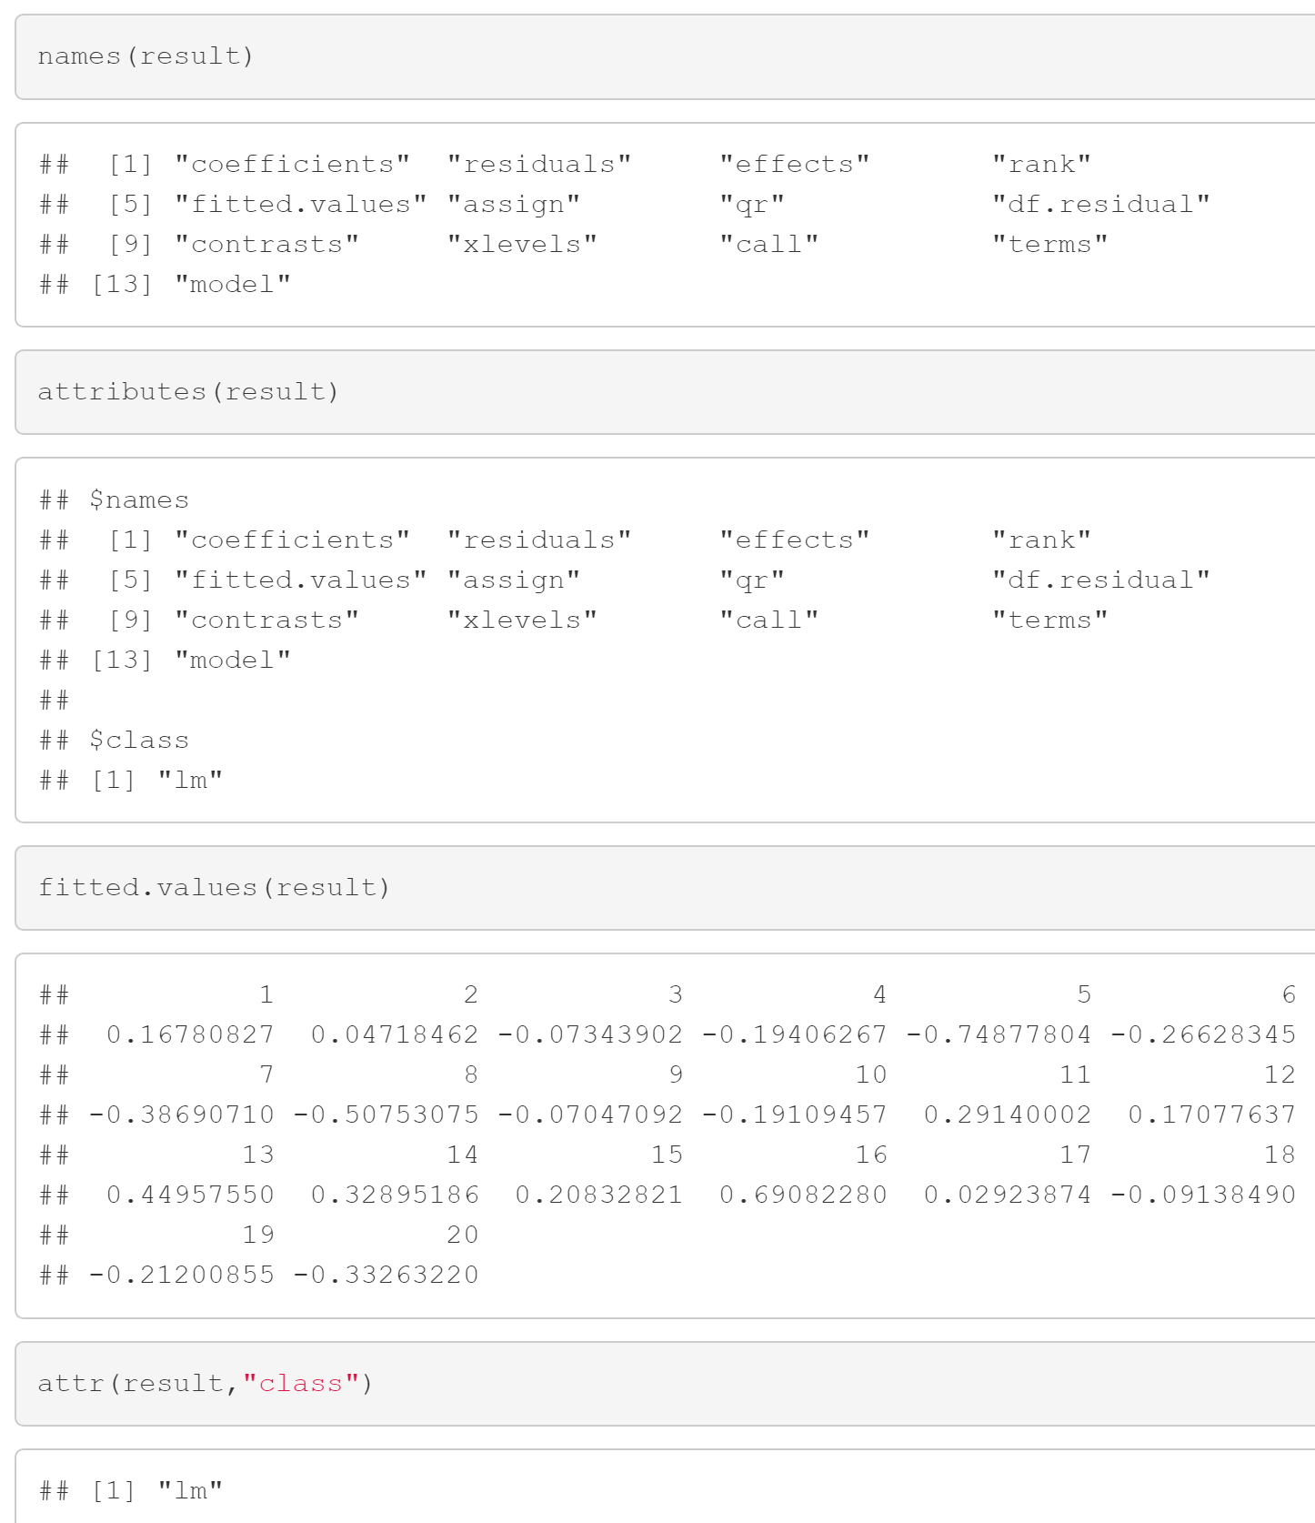
Inspection of recursive objects
See 6_Dataframes.Rmd
Atomic objects vs. „recursive objects“ like lists, arrays …
Important commands:
str
class
dimnames
names
attr
attributes

Slide 48
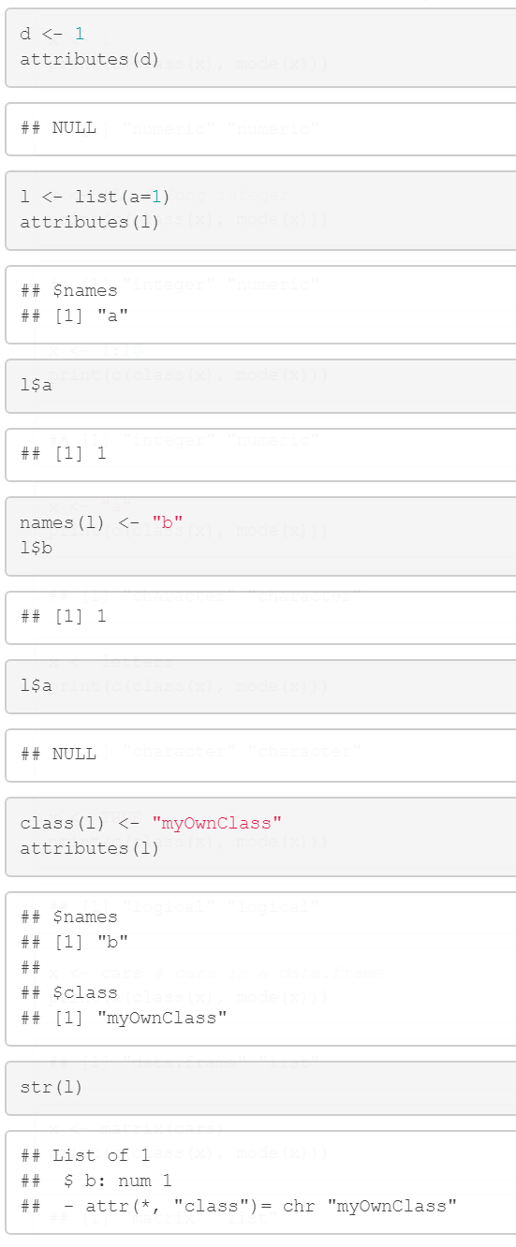
The „class“ attribute
Further illustration examples (see 7_ClassVsMode.Rmd )
If there is
an attribute „names“ then access via $ is feasible
an attribute „class“ then the class is indicated by that value
This is not real object oriented programming:
S3 classes are „like“ object oriented programming
S4 classes are „real“ object oriented

Slide 49
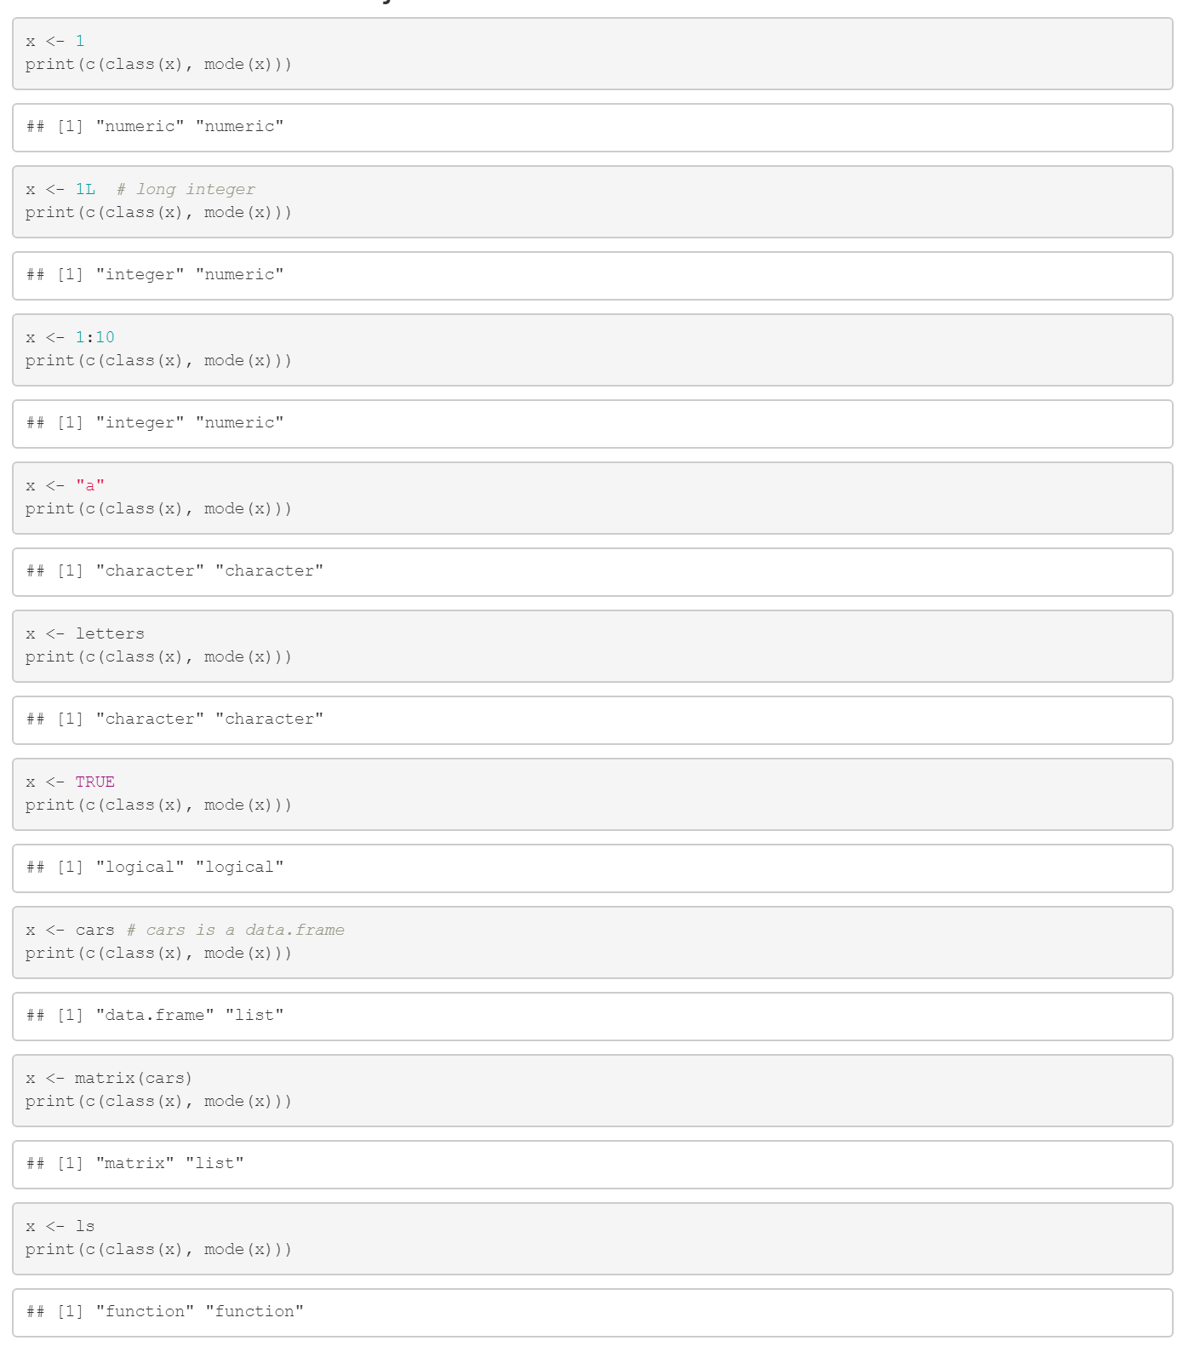
Overview about the standard classes in R
R distinguishes between class and mode (see 7_ClassVsMode.Rmd)
mode
is not used very much
mutually exclusive
related to storage
the most complex datatype that the object can hold
define a class implicitly when no explicit class has been assigned
class
can be changed by attributes
determines which generic function is called

Slide 50
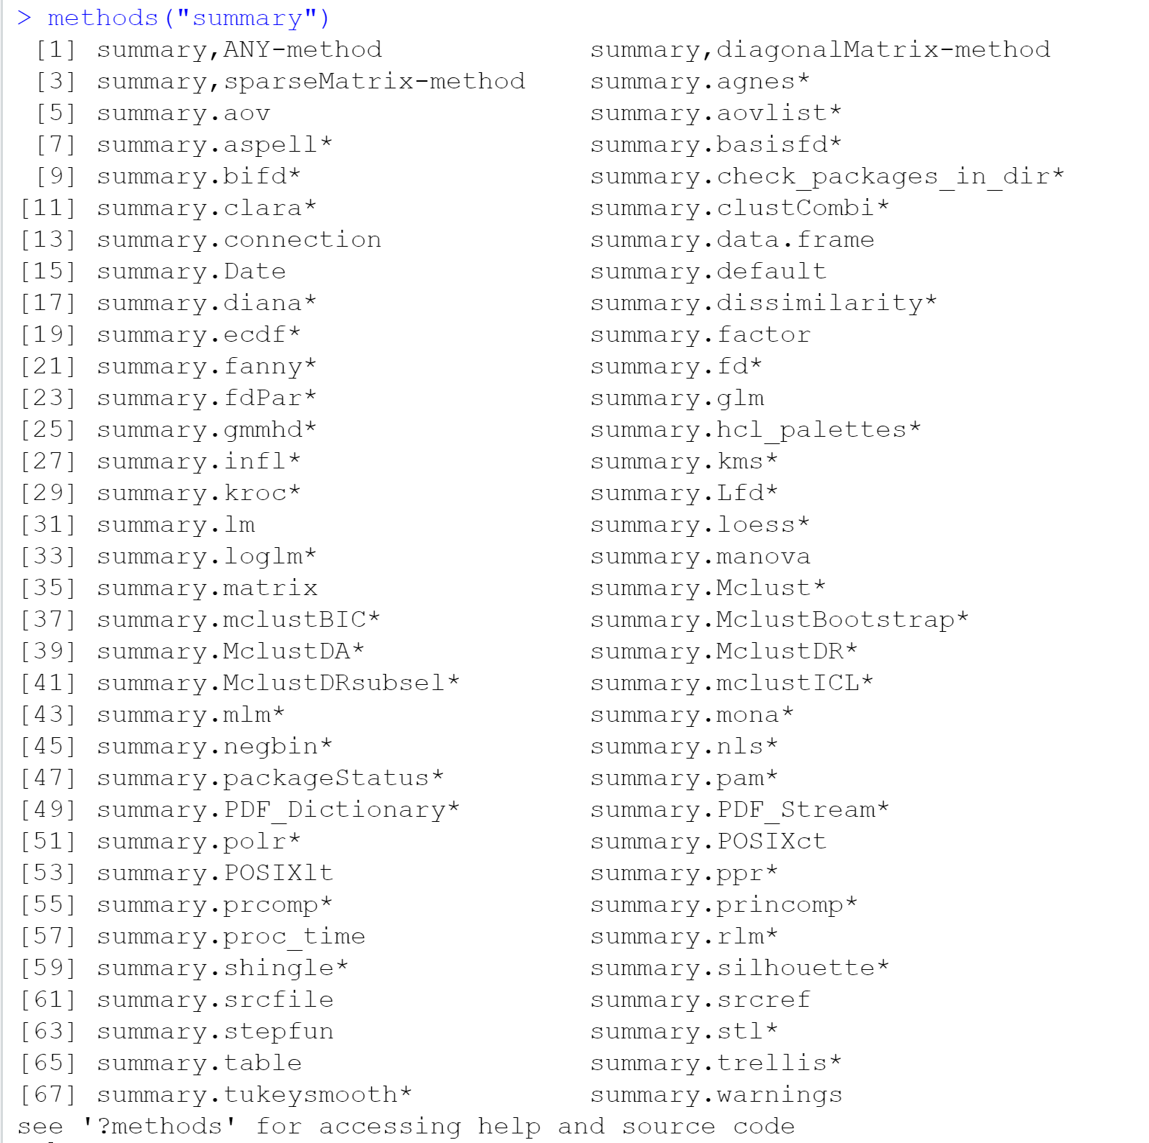
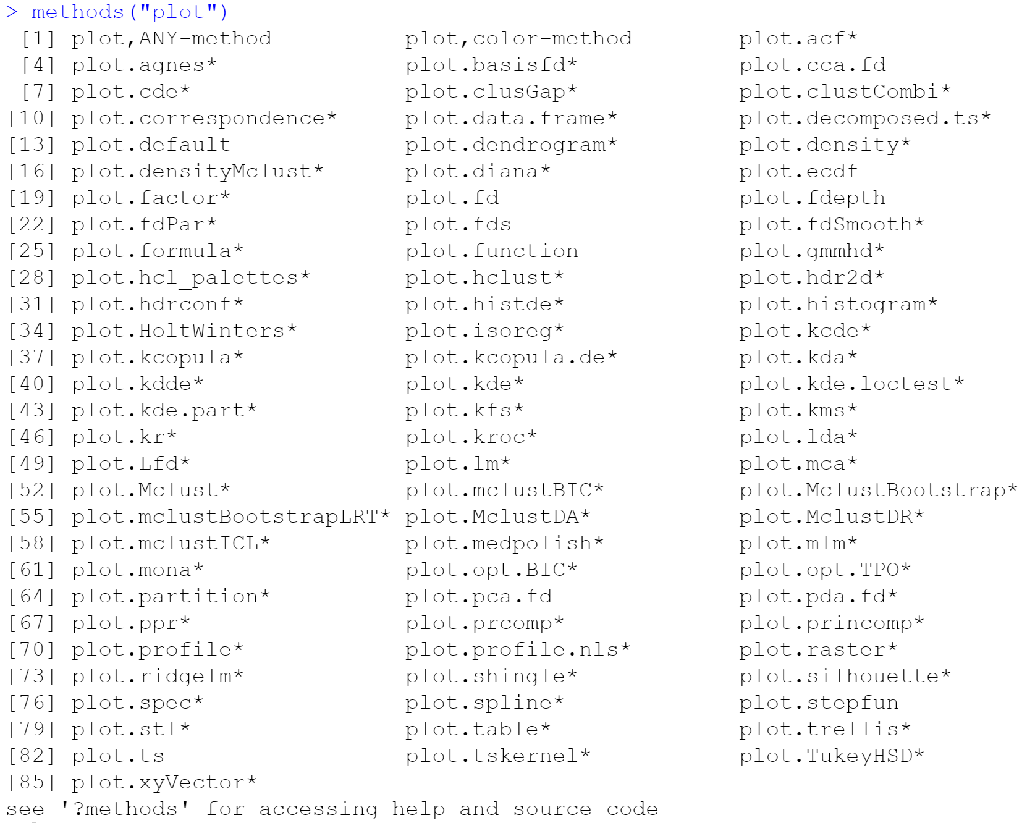
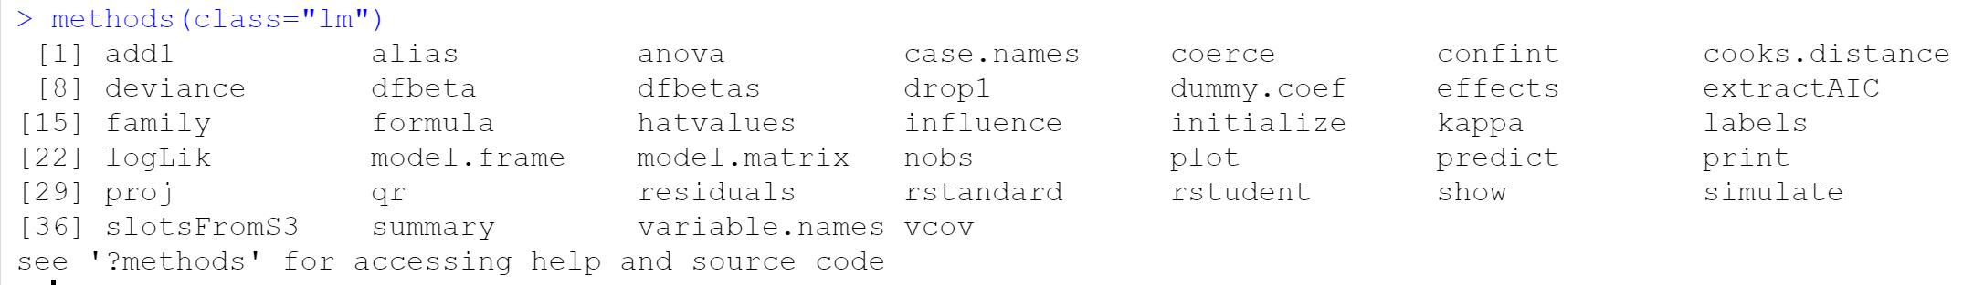
Available methods
See 7_ClassVsMode
The printed outcomes depend on the installation of packages.
For S4:
showMethods("list")

Slide 51
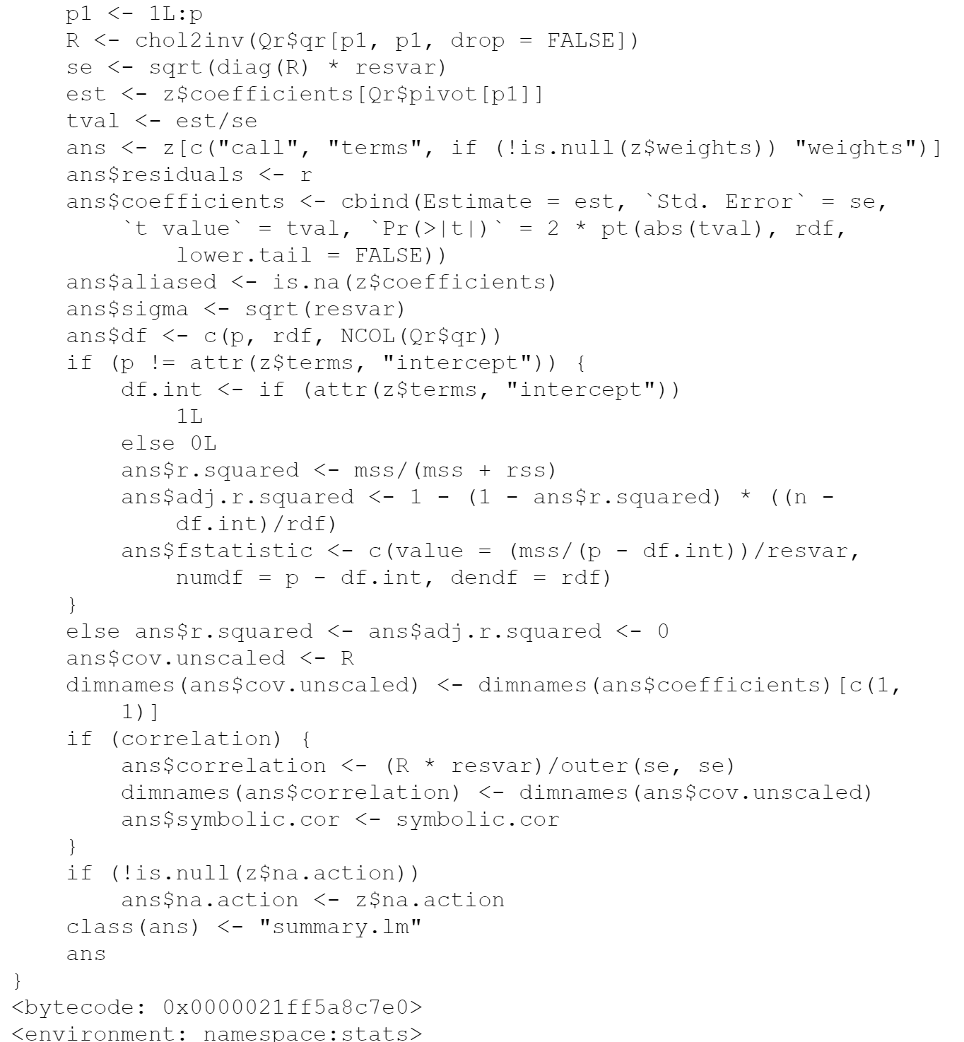
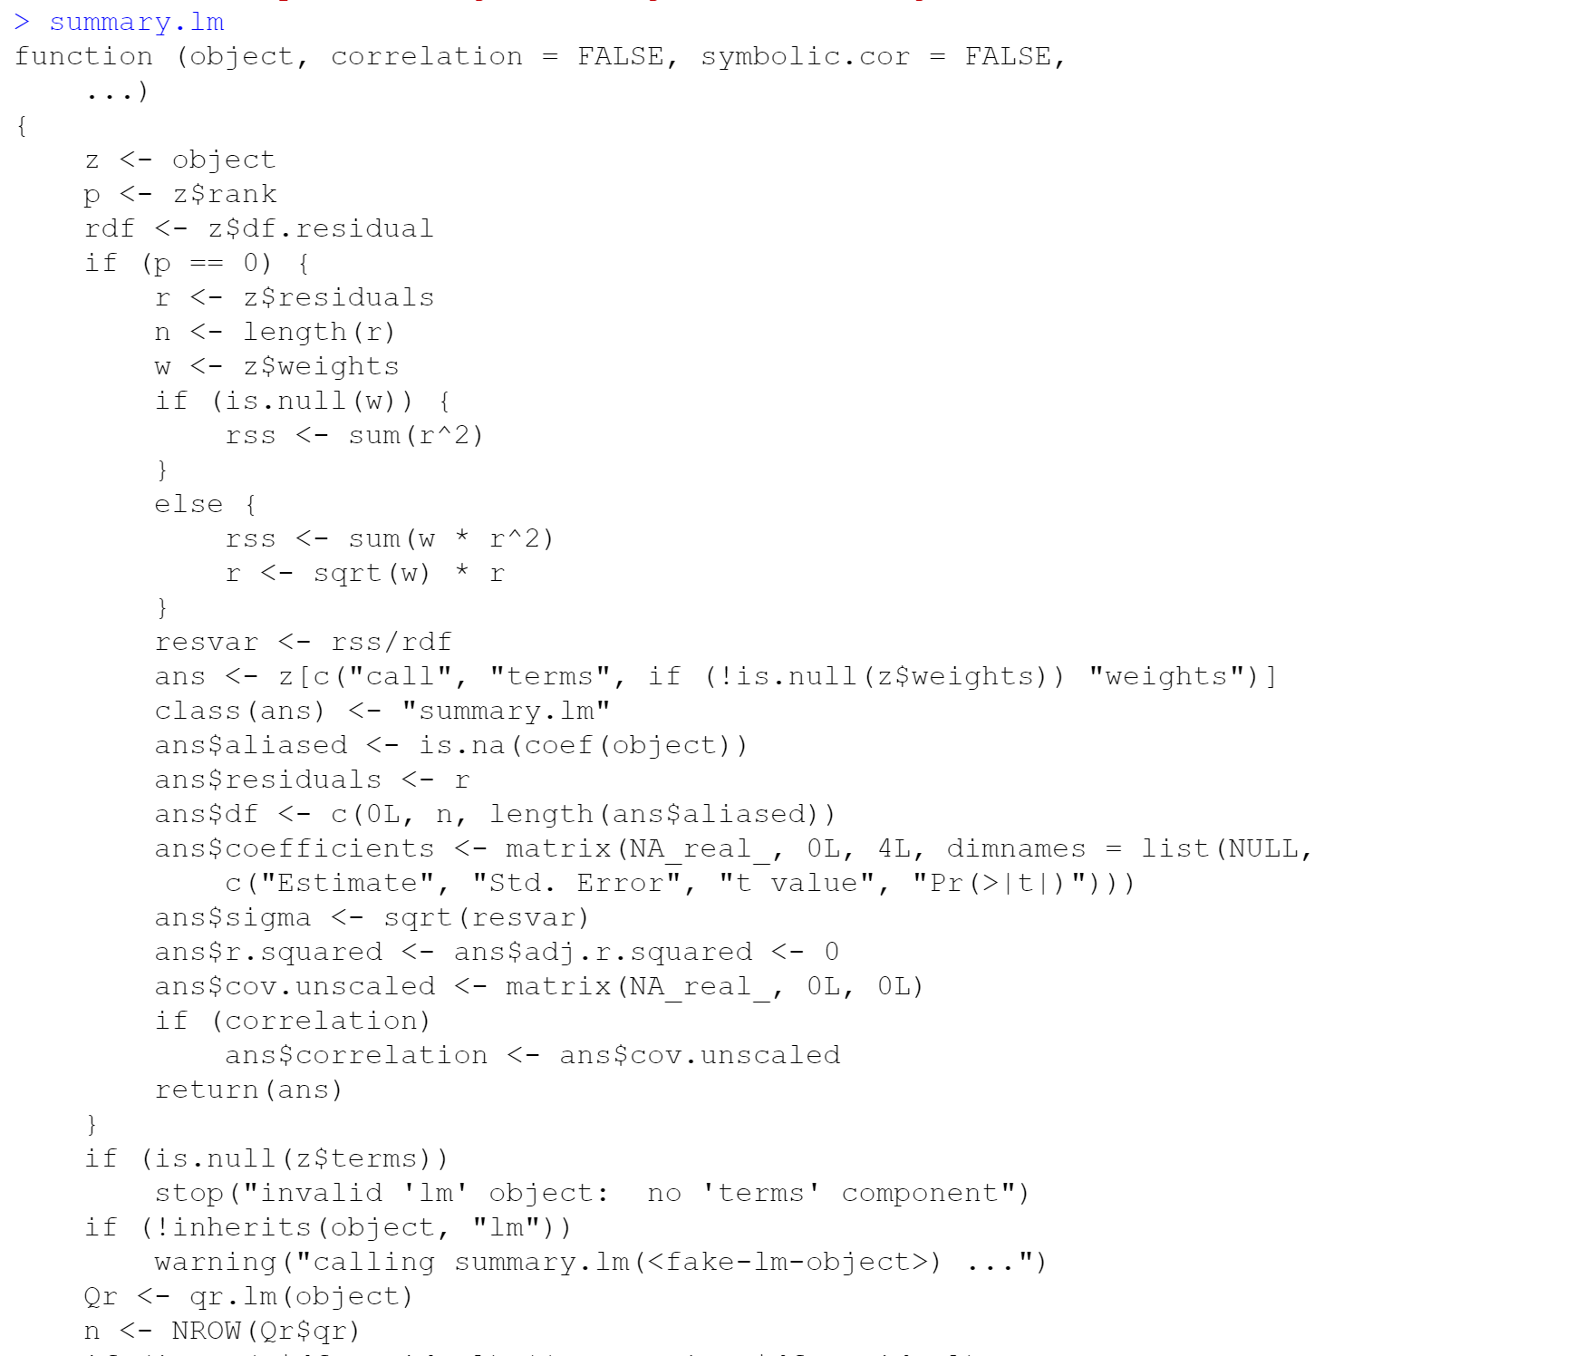
Overloading
How a custom plot method looks „in practice“
(…)

Slide 52

Make your own print function
Example: Overwriting the print function of a list
print.default könnte man auch noch überschreiben!

Slide 53

S4 classes: Real object oriented programming
See 8_S4classes.Rmd

Slide 54


The „SummarizedExperiment“ class
Related data frames (for one experiment), e.g. Omics data sets
Example for „rich data“: data of multiple sources e.g. meta information
see https://www.bioconductor.org/help/course-materials/2019/BSS2019/04_Practical_CoreApproachesInBioconductor.html

Slide 55

The most important classes in Bioconductor
Many packages build on these classes

Slide 56


GenomicRanges
Representation and manipulation of genomic intervals
Collection of genomic ranges (e.g. binding sites, transcripts, exons)
Implementation of interval operations
Compuationally efficient storage

Slide 57

Rle objects
Rle = vectors in run-length encoding format
Rle(values, nrepeat) # how frequently are values repeated
A sparse and efficient way for storing interval information

Slide 58
Making your own package

Slide 59


Creating your own package
Step 1: Create a project

Slide 60

Own package: loading a project
Step 2: The project is loaded

Slide 61

Own package: testing the files
Step 3: Check
Notes:
License: GPL-3

Slide 62

Own package: building and loading
Step 4: Install and Restart

Slide 63


Own package: creating installation zip-file
Build binary package

Slide 64
Hands-on: now try build your own package
If possible including your data simulation function

Slide 65
Debugging

Slide 66
What means „debugging“?
It‘s one of the most important things!
Debugging means stopping execution of the code at a specific point
The variables can be checked
Additional operations can be performed
Is highly valuable for finding errors and bugs
Standard debugging does not work in markdown files

Slide 67



Debugging example
Finding the problem if an error occurs

Slide 68
Summary

Slide 69




Summary
A quick review

Slide 70

A last hint
„One R tip a day“ on Twitter

Slide 71
Thanks for your attention. Questions?

Slide 72



http://www.stat.umn.edu/geyer/3701/notes/generic.html
Mit getAnywhere kann
man den Code auch sehen:
Oder bei bekanntem Package:

Slide 73


Slide 74

not intended
=> S4

Slide 75


Slide 76
Tibbles vs. data.frames
library(tidyverse)
Printing
Column names
Tibble: Nothing converted/created automatically

Slide 77


Slide 78

https://cran.r-project.org/doc/manuals/r-patched/R-ints.pdf

Slide 79


